Slide 1
Provider Onboarding Process
Indiana Homeowner Assistance Fund (IHAF)

Slide 2


Our Journey
Today
IHAF Program Overview
Program Timeline, Goals and Design
Homeowner Eligibility
Eligible Uses of Funds
Mortgage Servicer Agreements
Provider Onboarding
Portal Registration
Required Documentation
Data Exchange and Communication via Common Data File (CDF)
Q&A
Resources & Next Steps

Slide 3
IHAF PROGRAM OVERVIEW

Slide 4

What is IHAF?
The Indiana Homeowner Assistance Fund (IHAF) was created by the American Rescue Plan Act (ARPA) and is administered by the US Treasury. States, DC, tribes and US territories get a portion of the funds, which can be given to home-owning residents for housing related costs.
Mortgage Relief
ARPA
IN
HAF
IHAF
Insurance
Each IHAF allocation recipient can set their own additional policies and constraints on the funds, but in general approved uses are payments to bring a mortgage current including overdue mortgage payments and incurred fees, and additional costs involved in maintaining a home like property taxes and mortgage insurance. The Treasury has specific guidance to ensure that the funds are prioritized for social disadvantaged homeowners.
Program Admin Costs
Fees
Taxes

Slide 5
Program Goals and Design
$167 million from US Treasury ARPA program has been allocated to IN
Program Goal: Prevent homeowner mortgage delinquencies, defaults, foreclosures, and displacements that have been exacerbated by COVID-19
IHCDA is an administering agency for IHAF
  IHCDA, in collaboration with the Indiana Foreclosure Prevention Network, has partnered with Beam Longest and Neff (BLN) to provide a comprehensive technology and administrative services solution
Online application portal for homeowners and providers
Built-in housing counseling support

Slide 6
IHAF Timeline
The IHAF Program will follow this tentative timeline for soft-launch, application processing, and development of marketing materials.
February
March
Early-February: Soft-launch of IHAF program; application portal opens
Mid-February: Initial IHAF payments determined / disbursed
(Note that you need a signed agreement with the IHAF program for quickest payment options)
Mid-March:
Marketing and outreach materials will be shared with providers to aid outreach to borrowers as the program fully launches
*Please note that IHAF Program dates are flexible and subject to change.

Slide 7
Homeowner Eligibility
In order to be eligible, homeowners must:
The expenses an applicant is applying for must be related to their primary residence, located in IN
Applicants must have experienced a financial hardship, which can include but not limited to job loss, reduction in work hours, increased costs due to childcare, illness or the need to care for a family member, associated with COVID-19 after January 21, 2020
Applicants must have an income less than or equal to 150% of the county-level Area Median Income (AMI)

Slide 8
Eligible Uses of HAF Funds
Eligible uses of IHAF funds include but are not limited to:
Mortgage Assistance
Including but not limited to:
Financial assistance to allow a homeowner to reinstate a mortgage
  Principal, interest, taxes, insurance (homeowner’s and mortgage)
Payment assistance for other housing related costs related to a period of forbearance, delinquency, or default
Property Charges Assistance
(Eligible only as necessary to facilitate a reinstatement)
Including but not limited to Payment assistance for homeowner’s:
Homeowner’s or condo association fees or liens

Slide 9
Provider Agreements
Programmatic agreement between BLN and provider
Outlines the terms of provider participation
Mutual understanding about the program's intent, its function, and the important roles that BLN, IHCDA and the servicer play
  Timing
  Nonpublic personal information
  Data and information exchange
  Points of contact
These agreements make it easier for you to see and track your borrowers in our system, help ensure correct payment amounts, and significantly expedite your receipt of funds for approved borrowers.We strongly recommend these agreements for those interested in receiving aid on behalf of borrowers from IHAF.

Slide 10








IHAF Provider Journey
Providers can generally expect to follow this journey if they are participating in IHAF.
Start HAF Process
KEY
 | Homeowner
 | HAF Case Manager
 | Providers
Providers attend webinar and review materials
Providers review and sign the Servicer Agreement and onboard into FAMS system
Communicate with Delinquent Homeowners
(Gather lists and send Servicer Outreach Letter)
IHAF Housing Counselors and Case Managers review case
Application Portal opens and Homeowner completes the IHAF application
Exchange data via CDF with Servicer to confirm the payment amount and types
Application underwriting and final reviews occur
Eligible payments are disbursed to Servicers and other entities
Note:This is not an exhaustive list of activities

Slide 11
Roles & Responsibilities
Providers
Attend provider webinar and any follow up trainings
Review and sign the Servicer Agreement (mortgage servicers only)
Onboard into the FAMS provider portal for easy access
Facilitate communication to potentially eligible borrowers (option to leverage material that will be made available in February)
IHAF Program & Subcontractors
Host the application & case management portals
Accept applications and necessary documentation
Review applications and documentations to determine
eligibility against Admin Plan and Treasury guidance
Communicate with provider to confirm amounts owed for each borrower, types of fees needed for reinstatement, and to facilitate payments
Onboard and train providers (including gathering Servicer Agreements)
Onboard and train BLN support for IHAF applicants
Conduct marketing & outreach to potentially eligible
borrowers alongside provider outreach
2/8/2022

Slide 12
PROVIDER
ONBOARDING

Slide 13
IHAF Program- Onboarding into FAMS system
Financial Assistance Management System (FAMS) provides a self-service portal for providers who wish to participate in the IHAF program.
This portal will allow providers such as mortgage service companies, HOAs, property insurance companies, counties, municipalities, and other property tax collection agencies to interact with entities who administer IHAF programs.
Providers will be able to submit their onboarding information, servicer agreements (if required), and payment information, as well as set up a secure FTP channel to send/receive Common Data Files (CDF).
This portal can also be used to exchange other data extracts between the IHAF Program and providers.

Slide 14
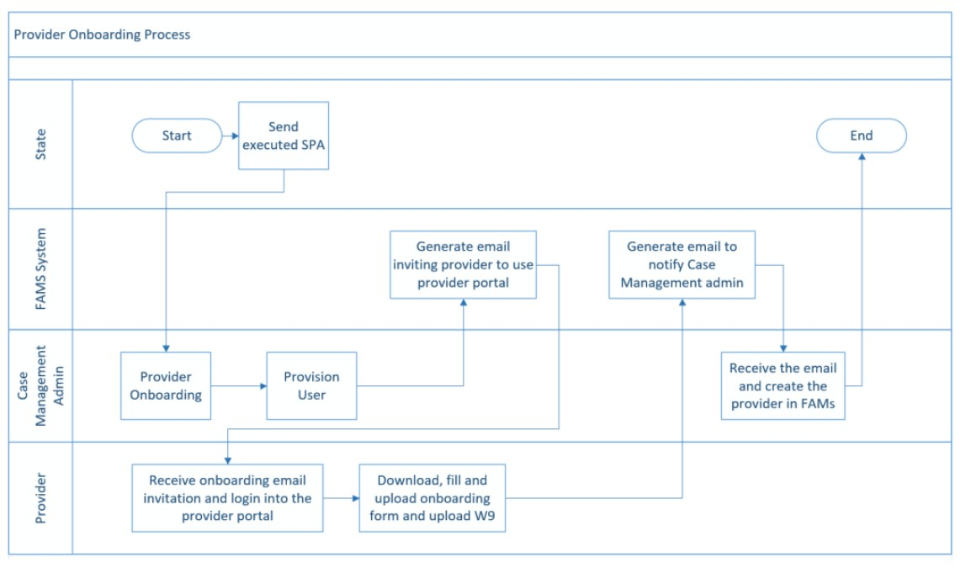
Provider Onboarding Process
Note: Mortgage servicers agreements may only be required of mortgage providers; other entities may skip this step, instead providing contact information for outreach

Slide 15
Onboarding – Step 1 for Mortgage Providers
Once a Mortgage provider has agreed to participate in the IHAF Program, the Provider will be requested to execute a Mortgage Servicer Agreement with BLN (as required).
Once the Mortgage Servicer Agreement is obtained by the IHAF Program, the Provider’s designated representative will receive an email from the Program inviting the Provider to the Portal to submit additional information.

Slide 16
FAMS Portal – Access and Directories – Mortgage Providers
Each Provider will be setup in the FAMS Provider Portal with a pre-defined directory structure for exchanging information with the Program. Individuals representing these providers will be provisioned in the Portal with access to a directory structure.
Mortgage Providers will have access to the following directories:
  W9 Form
  Reports
  Servicer Participation Agreements (SPA’s)
  Onboarding Form
  Common Data File (CDF)
    1 Outbound Folder Structure
    1 Inbound Folder Structure
The onboarding form, found in the Portal, must then be completed by the provider to complete the setup process and receive payments from the Program.

Slide 17
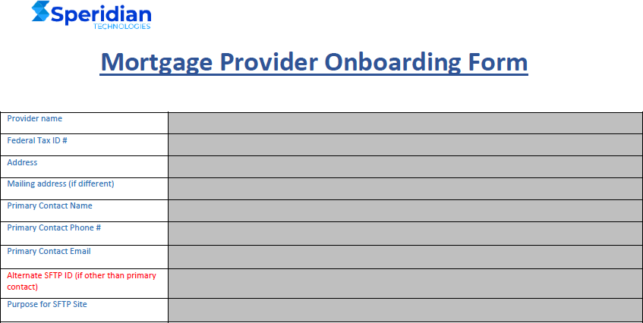
Sample FAMS Provider Onboarding Form – Mortgage Providers

Slide 18
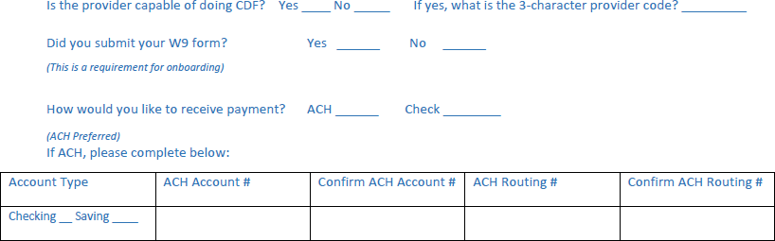
Sample FAMS Provider Onboarding Form – Mortgage Providers

Slide 19
What is the Common Data File?
The Common Data File (CDF) is a foundational business tool designed to be a standardized communication method for confidential homeowner, loan and program information between state agencies and mortgage loan servicers –particularly multi-state servicers.
  It was used to support and standardize servicer participation in the Hardest Hit Fund (HHF) Programs and will serve the same function for Treasury-approved Homeowner Assistance Fund (HAF) Programs.
  The CDF will help states send and receive information with participating servicers as necessary to
determine HAF program eligibility.
  CDF version.7.3 has been modified with six, new data fields designed to support HAF Program processing.
  Training and other supplemental materials are intended to complement the revised CDF Toolkit v.7.3
  The Program will provide servicer training on CDF exchange protocols

Slide 20
RESOURCES & NEXT STEPS

Slide 21
Resources
IHAF Site
Visit Indiana’s Homeowner Assistance Fund (IHAF) | 877-GET-HOPE (877gethope.org)for more Servicer-specific details

Slide 22
