Slide 1



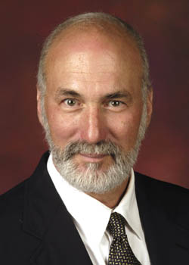

“Blight Elimination Program” Initiative of
IHCDA’s Hardest Hit Funds:
Repurposing Demolished Sites
Reinvesting in Neighboring Properties
Presentations 4/8 – 4/22/2014
Site selection, control, reuse
PART B
1:00-3:00 pm
Bruce Frankel
Professor of Urban Planning
Director, Real Estate Development Programs

Slide 2
Order
Inventory of Essential Indiana Cities & Towns: Sets of Issues & Assets
Central Theme of Causes - Vacant & Abandoned
Shrinking Cities or Opportunity for Demand?
Inventory of Underutilized Resources
Inventory of Proven Strategies

Slide 3
4d. AHP of FHLBI
Affordable Housing Program of FHLBI | Provides a direct subsidy (grant) for acquisition, rehabilitation or construction of affordable housing of various types – up to $500,000 Only FHLBI members may apply for AHP funding; 412 institutions as participating members in FHLBI Housing sponsors are non-profit or for-profit housing developers, including land banks, who partner with FHLBI member Eligible Activities Land or building acquisition Down payment and closing costs for homebuyers Construction or rehabilitation costs Owner-occupied rehabilitation Some soft costs (developer fee, architectural, legal, survey, engineering) | Under-utilized funds for redevelopment; no limit to fundable applications of FHLBI members

Slide 4
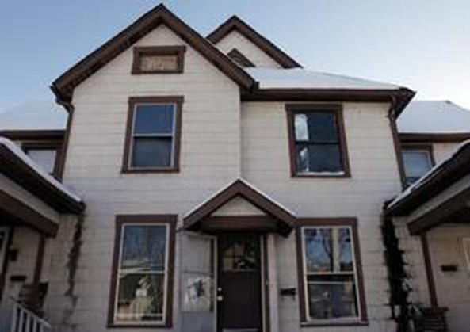
AHP in Practice - Muncie
Learn the “How” in fall workshops
Funding Source
AHP, FHLBI | $500,000
City CD Office | $86,700
Nonprofit Landlord - PathStone | $30,000
Mutual SB | $46,100
 | $662,800
Critique?
@ 7% on $76,100 invested privately, the per unit cost is $158 / mo. [$111+35+12]
@65% AMI, 2-BR d.u. affordability = $688 / mo.
Per d.u. capital cost = $165,700
723 W. Main St., Old West End Place Apartments
“Where my mail is commonly sent,” said Frankel.
4-plex
Capacity for 17 apartments or SF homesteads

Slide 5
CDBG/HOME Strategy [Frankel 1978-2013]
35 years
Structured Loan
Results
$2.7M HUD funding
  CDBG 1974
  HOME 1990
Invested in Code-Deficient Homesteads @ 20% [Leverage 5/1]
Average $30K
Deferred Payment Loan as “soft-second mortgage” [non-amortized, balloon due at resale]
Returned average 5% annually and reinvested
Can accrue below-market interest or structure as shared appreciation
Results here at no interest or shared appreciation
At $30K rehabilitation cost, then
270 annual/ 9,720 over 35 years
  @$30K performed rehabilitations annually from CDBG/HOME allocation
+ progressive 14 to 486 d.u.’s annually/ 8,991 over 35 years
  @$30K performed rehabilitations from program income
IF at $100K rehabilitation cost, then
5,613 d.u.’s served over 35 years
  2,916 from CDBG/HOME [81 annually]
  2,697 from program income [4 to 146]
9,720
8,991
2,916
2,697

Slide 6
5. Nonresidential
Instead of FHA, go to SBA

Slide 7

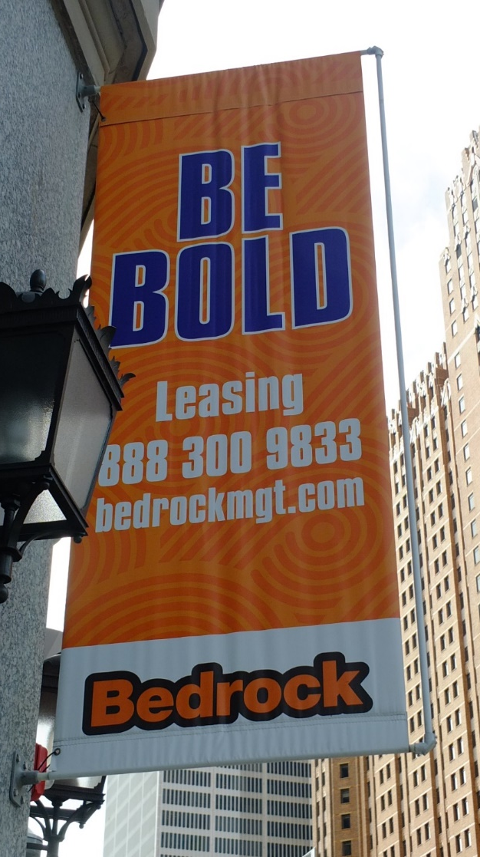
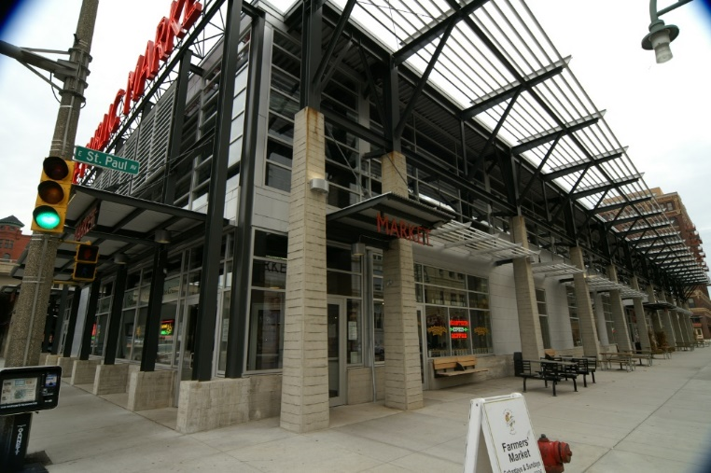
Ease of Entry
Ease of Entrepreneurship
Muncie
Another form of urban farming
Detroit
Milwaukee

Slide 8
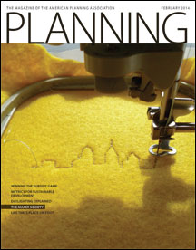
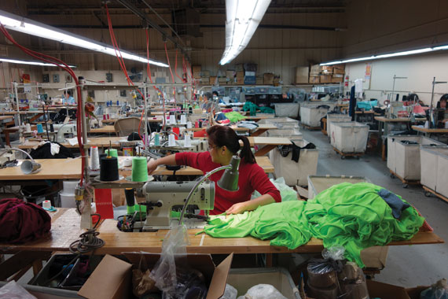
PDR
Production/ Distribution/ Repair [PDR]
February, 2014

Slide 9
New Urban Manufacturing
PDR
References/ Facts
Principles
Brookings study 2007
  >50,000 manufacturers
  <20 employees/each
Creative Class artisans
PDR= [Light] production, distribution, repair
$60,000/yr.
Conditions for the Creative Class
Industrial-friendly zoning
  I/C and I/R
  [make/sell; live/work]
Spaces
Access
Retention
Philadelphia, San Francisco/ Oakland, Atlanta, Wilmington, NC…Rising Sun, IN

Slide 10
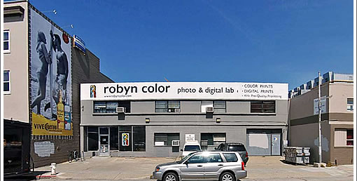
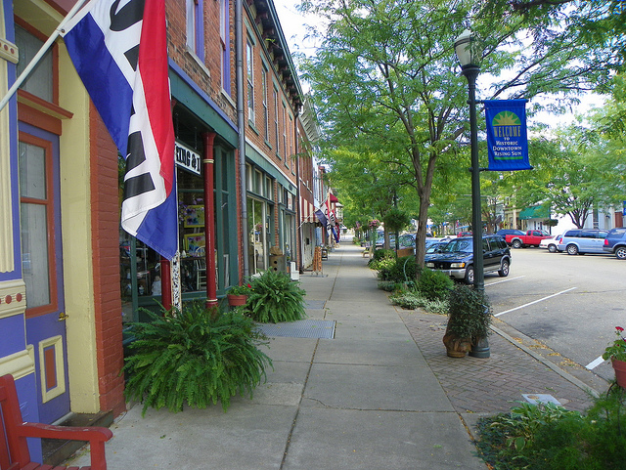

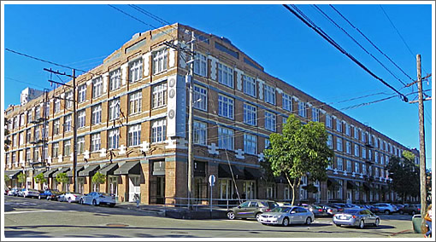
PDR’s
work/sell in Bay Area
Live/work/sell in Bay Area
Live/work/sell [Internet]/ distribute [UPS] in Rising Sun

Slide 11
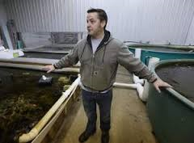
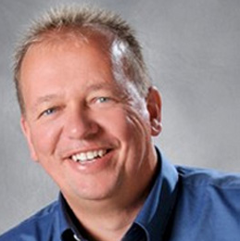
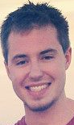
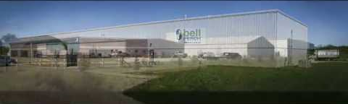
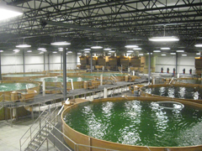
Aquaponics/ Agriponics
Ready for Prime Time?
ECSIA [Environmentally Controlled Sustainable Integrated Agriculture] www.ecsia.us
Sales ~ $15M, employed 69 in 2012 in Indiana
Professor Scott Truex, Sustainable Communities Institute
Glen Barber + Norman McCowan – Bell Aquaculture, Redkey + Albany facilities [yellow perch]; seeks commercial facility in Muncie, role of Justin Long, BSU
Laura Tiu, OSU aquaculture extension specialist; PU’s Aquaculture Research Lab
RACER Trust – 2011 Bankruptcy Court order clean-up of 44 M s.f. of GM plants
Incubator?
Glen Barber
Norman McCowan
Justin Long

Slide 12

Public Center for Economic Development 3rd Ward Milwaukee

Slide 13
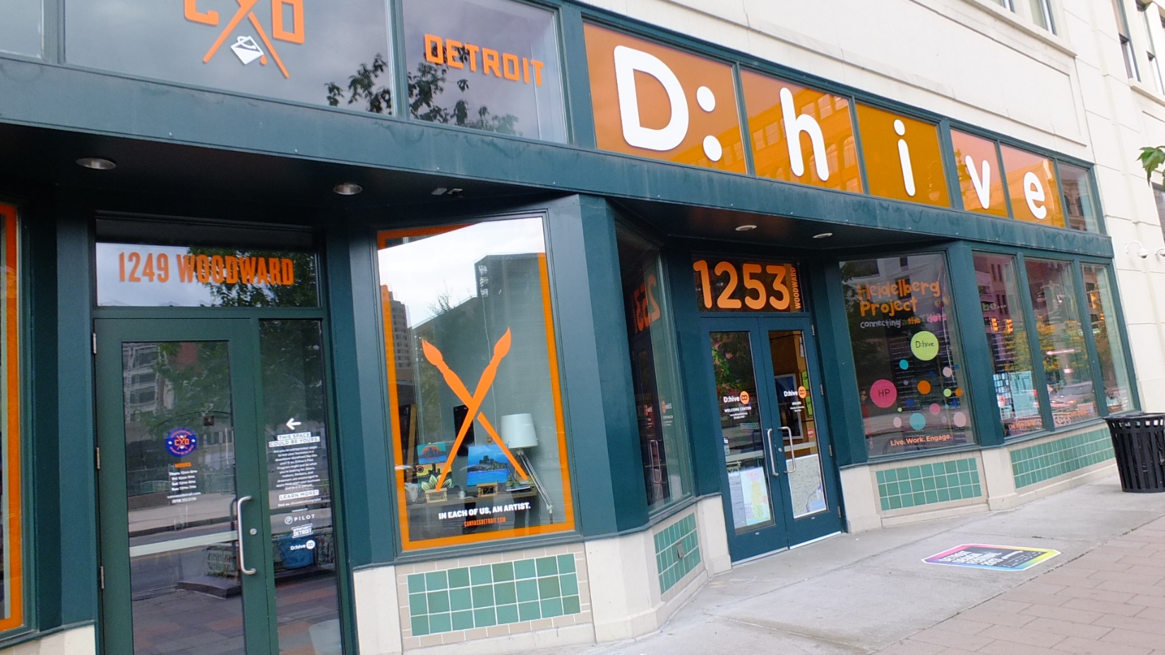
Incubator/ Promoter

Slide 14
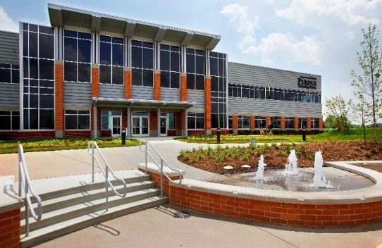
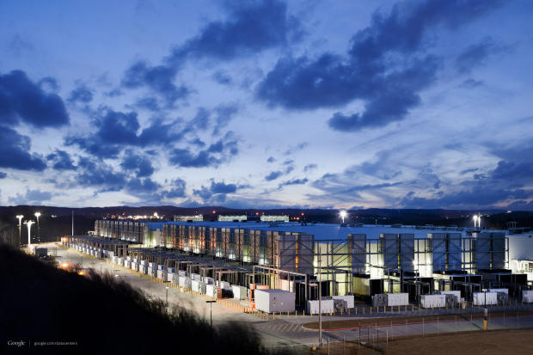
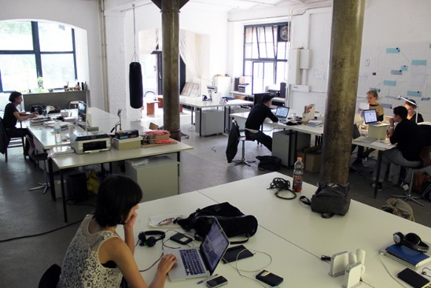
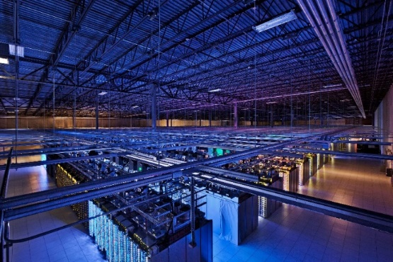
Data Center for Greenfield, Hancock County
Market Conditions
Pricing
  Educational center/business incubator space – 15$/s.f.,
  1 year lease with renewal options and early-out for successful businesses
  Data center – 90-150$/sq ft –10 year lease with options for renewal
Market preferences

Slide 15
Data Center Finances
$143 M capital Cost + $19 equipment
$28M Net Operating Income
35% ROI
Justifying $54M in equity
LTV 60% for debt with rapid payout [15 years]
Servicing all other business in your local economy, with significant multiplier effect

Slide 16
4e,f
Program | Purpose | Comment
New Market Tax Credits | Residential or Nonresidential properties in eligible neighborhoods of poverty [72 neighborhoods in Indiana qualify] Requires certified Community Development Entity [CDE] 39% tax credits over 7 years calculates to 30% of qualified basis E.g. on $100,000 qualified total cost, $30,000 in NMTC financing | Highly competitive, only 10% of applications are funded per annum.
SBA Programs as loan guarantees = “debentures” | 7a - $5.0M max; average 2012 $337,730; insures 75-85%; realty, personalty, working capital Microloan - $50K max/ 6 years; average 2012 $13K; all but realty CDC 504 - $5.0M [any business] - $4.0M [small manufacturers] debenture max [so, 100%]; $65K per worker retained or added [up to $100K in small manufacturing]; only realty + equipment. All programs SBA fee 2-3%; terms realty 25 years, personalty 10 years | Strategic decision: Is it real estate? OR Is it a business involving real estate +?
Resource Guide

Slide 17
TIF/ IDB
Industrial Development Bonds
Local Unit/ Economic Development Commission
  sells taxable economic development revenue bonds
  to subsidiary or affiliate of developer
  tax increment underwrites bonds, pursuant to a trust indenture with a trustee
Bond proceeds loaned to developer
  Promissory note obligates developer, as a credited/offset
  Can add credit enhancement [LOC]
Economic Development
Redevelopment
TIF under Redevelopment Code since 1975, but significant amendments

Slide 18
TIF/ HoTIF Bonds
Tax Credit Syndications…General Rules
Consolidation/ Consortium of Sellers
  Aggregate of properties
  Cooperation with area local governments with common underwriting standards
  Cost-efficient large issues and equity syndications
Consortium of Buyers
  Local or national lenders, brokers
  “Place-based” tranche, your own socially-responsible bank

Slide 19
6. Mixed Use
“Urban” in full as urban infill

Slide 20




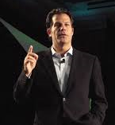
Maker District
Muncie, April 3-4, 2014
https://munciearts.org/
Symposium movie
http://www.artplaceamerica.org/
collaboration among:
14 foundations,
8 federal agencies, and
6 financial institutions
dedicated to strengthening the field of creative placemaking.
http://kresge.org/programs/arts-culture/harvesting-leading-practices
We seek to gather knowledge about how and under what conditions creative placemaking contributes to strengthening neighborhoods and to revitalization. We are interested in the economic, social and cultural changes associated with creative placemaking and in gathering data about its impact.
2002… 38M

Slide 21


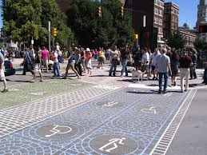
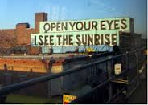
Quality of Place
Helen Davis Johnson
Wheeler Arts Community, Fountain Square, Indianapolis
Launch Fishers
basement library
People for Urban Progress, Indianapolis
Spaces where art happens
  Food is art
  Open & Inviting
  Experimentation
  Creativity as an economic engine
  Uniquely local
36 live/ work
Long-term viability
Economy
Access
Safety
Public utilities/ public goods
Urban amenities
Equity/ Affordability
…
An artist who makes things…makes things happen
325 members, 16,000 s.f.
$500/yr.
Scavengers “Goods for Good”
13 AC Teflon- coated fiberglass RCA Dome; $15K landfill;
0.1 AC $70K
Cultural Trail, Indianapolis

Slide 22

Local economy [Economic Development] has become a “place”
Urban CTP
Live
Learn
Work
Play
Shop
Edward McMahon,
ULI Fellow
“new paradigm for commercial development”
Urban Land
3 / 2012

Slide 23

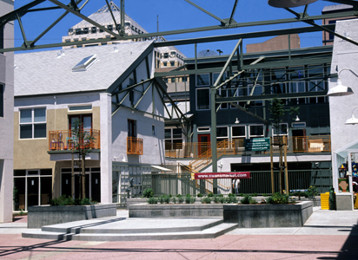
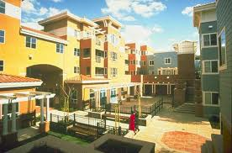
Michael Pyatok
Oakland, CA
Work
Live
Shop
Transforming a defunct big box in a high crime neighborhood to a
gated, mixed-use, urban community
Mentioned above the well-suited use of HoTIF with mixed-use residential

Slide 24
Catalytic Strategies –
For advanced workshops in October
all case studies
Neighborhood Redevelopment Strategy Area [NRSA]
  16 neighborhood conditions
  7 redevelopment strategies
Community Development Plan
Business Plan
Resources [“foreign aid”]
Sustainable CDBG/ HOME
Placed-based financing
  Health care [VT, Frankel]
  Higher education [Kalamazoo]
Strategies
  The local economy as a place
  Manufacturing…”Its alive!”
  Adaptive reuse empty downtown office/ floors above ground floor retail

Slide 25
Capital Raised by
Tax Increment & Tax Credit Financing
Tax Increment
Average = 2% [MC=6%; less 200 basis points]
$50,000 [33%]
Federal/ State HTC
ROI blends 20% + 20%
$37,100 [25%]
NMTC
ROI 39%
$40,300 [27%]
Tax Increment
$50,000
33%
HTC
$37,100
25%
NMTC
$40,300
27%
Combined
$127,400
85%
72 areas;
10% chance; consor-tium
Homestead @ 25%
Non-residential @ 50%
Qualified Basis = $100,000
Total Development Cost = $150,000
Ignores LIHTC @ $12,000 - $49,500
[8 - 33% TDC]

Slide 26
4f. Mixed-Income Solution
 | 50% AMI | 80% AMI | 120% AMI | Cost Mixture | Sold Price Mixture | Net Proceeds Mixture
 |  |  |  | $ 370,000 | $ 370,000 | $ 0
Market Price | $ 110,000 | $ 130,000 | $ 170,000 | Bold represents sold price [lesser of affordable and market prices]
Cost | $ 100,000 | $ 120,000 | $ 150,000
Affordable Price | $ 80,000 | $ 120,000 | $ 180,000
Surplus [Subsidy] | $ (20,000) | $ 0 | $ 20,000 | <- Sold Price - Cost
Conceptual Numbers

Slide 27
4f. Actual Numbers
Direct Costs and Revenues | Average per Property | Total
Dwellings | 1.20 | 60
Bedrooms | 3.02 | 151
Assessed Value | $25,482 | $1,274,100
Proposed Acquisition Value @ 85% Assessed | $21,660 | $1,082,985
Demolition Cost | $7,732 | $61,856
New Construction Cost | $160,521 | $2,889,375
Rehabilitation Cost | $90,119 | $2,883,800
Total Direct Cost of Acquisition & Development | $138,360 | $6,918,016
Revenue from Sales | $170,200 | $8,510,000
Surplus [Deficit] before indirect costs and administration | $31,840 | $1,591,984

Slide 28
Thank you!...Stay in touch!
Means of contact:
Bruce Frankel 765-285-5869
Professor of Urban Planning bfrankel@bsu.edu
Director Real Estate Development Programs Blog:
Department of Urban Planning
AB 307
Ball State University
Muncie, IN 46306
http://www.877gethope.org/blight
http://www.in.gov/ihcda/2340.htm

