Slide 1





“Blight Elimination Program” Initiative of
IHCDA’s Hardest Hit Funds:
Repurposing Demolished Sites
Reinvesting in Neighboring Properties
Presentations 4/8 – 4/22/2014
Site selection, control, reuse
PART B
1:00-3:00 pm
Bruce Frankel
Professor of Urban Planning
Director, Real Estate Development Programs

Slide 2
Order
Inventory of Essential Indiana Cities & Towns: Sets of Issues & Assets
Central Theme of Causes - Vacant & Abandoned
Shrinking Cities or Opportunity for Demand?
Inventory of Underutilized Resources
Inventory of Proven Strategies

Slide 3
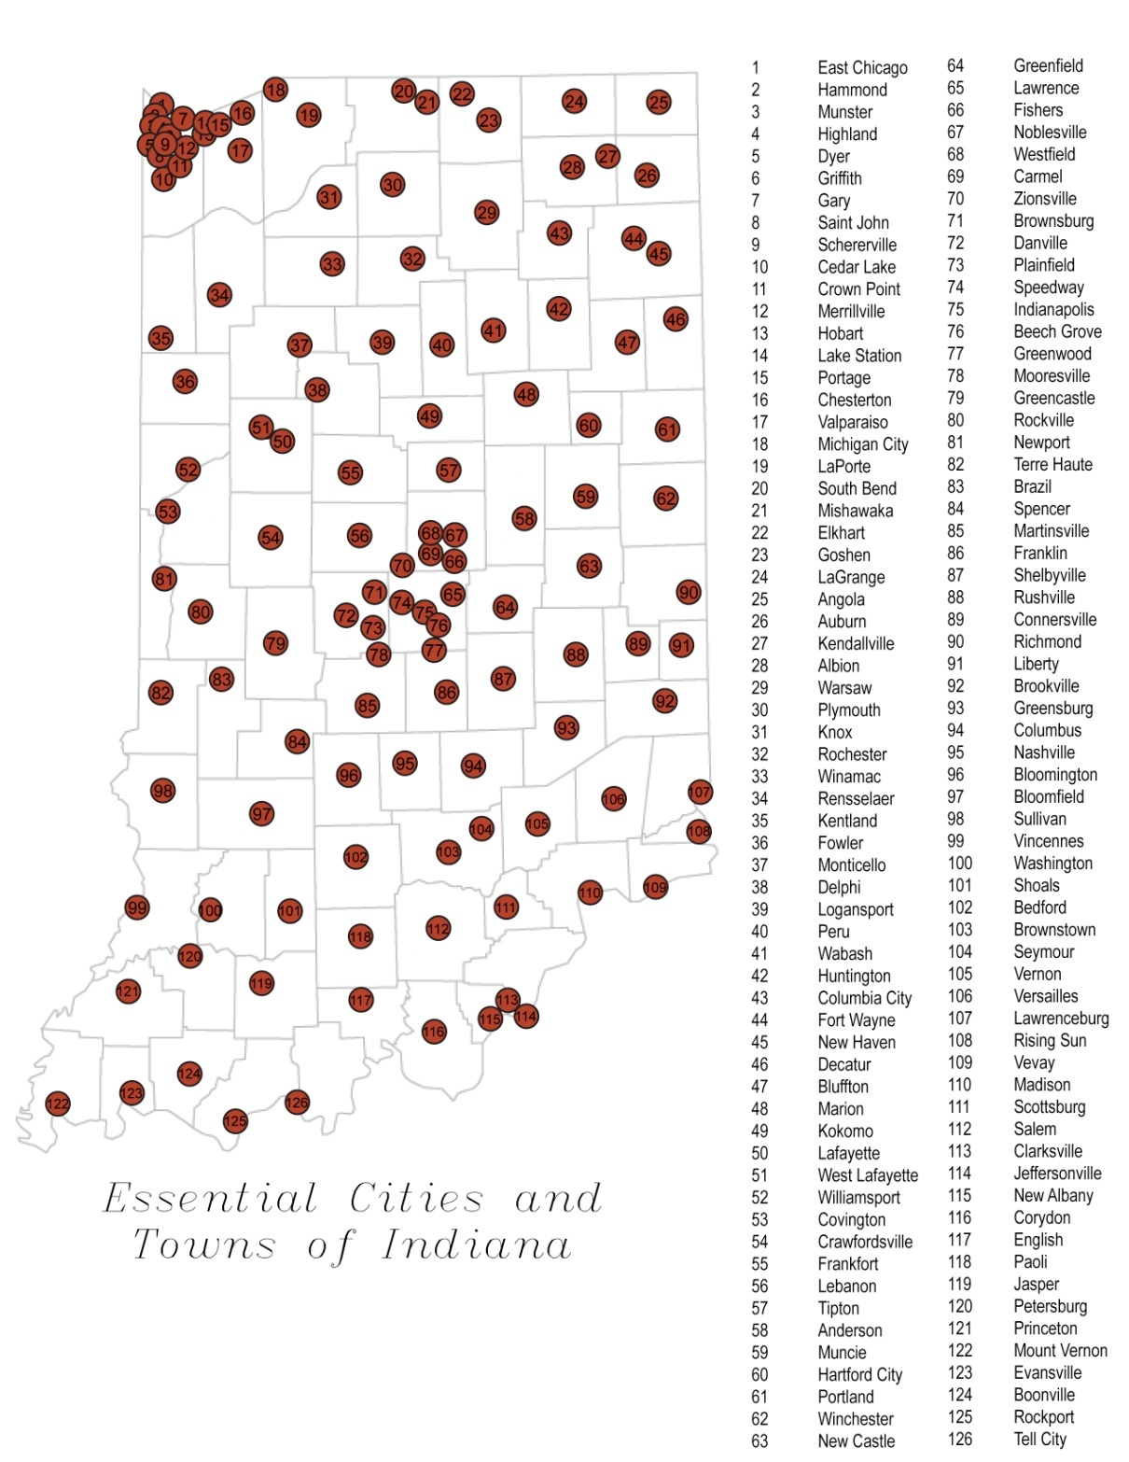
1. Inventory Essential Cities & Towns
According to the State Board of Accounts, Indiana has 119 cities and 447 towns. Municipalities are classified according to their status and population as follows:
Status and Population | Class | Number
Cities of 250,000 or More | First Class Cities | 1
Cities of 35,000 to 249,999 | Second Class Cities | 19
Cities of Less Than 35,000 | Third Class Cities | 99
Other Municipalities of Any Population | Towns | 447
Total | -----------------------→ | 566
In defining the ‘essential’ cities and towns in Indiana, we begin with a list of all cities and towns in Indiana. This is then condensed down into the 77 places that have populations of at least 10,000 people, and 49 county seats that did not qualify as having 10,000 people. Thus, we have included all 92 county seats, and another 34 major cities that have at least 10,000 people.
126

Slide 4
Distressed/ Stressed/ Special Assets
Distressed-
Declining in population- Cities and Towns showing a population decline of greater than 1% from the time of the 2001 census to the 2006 interim census
Pronounced Economic Distress- Cities and towns with a poverty level above the Indiana state average of 10%
Redevelopment Cities- Places with Tax Increment Finance Districts (TIF), Redevelopment Commissions/Staff skilled in redevelopment initiatives, or both
Stressed-
Fast Growth- Cities experiencing population growth faster than the Indiana state average of 3.8%
*Special Assets-
Historic- Places with at least one Historic District as well as buildings on the National Historic Register
College Towns- Places that have educational institutions with significantly large (1,000+) student bodies, either state or private universities/colleges
Casino Towns- Places that have casinos, generating an important specialized form of revenue for the community

Slide 5
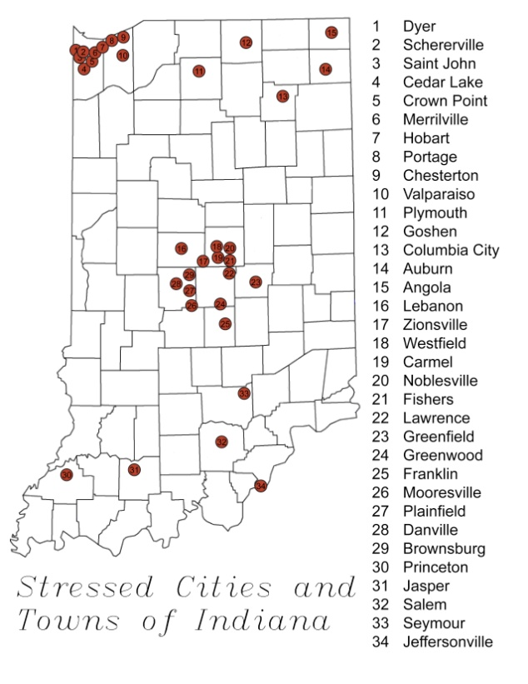
Stressed

Slide 6
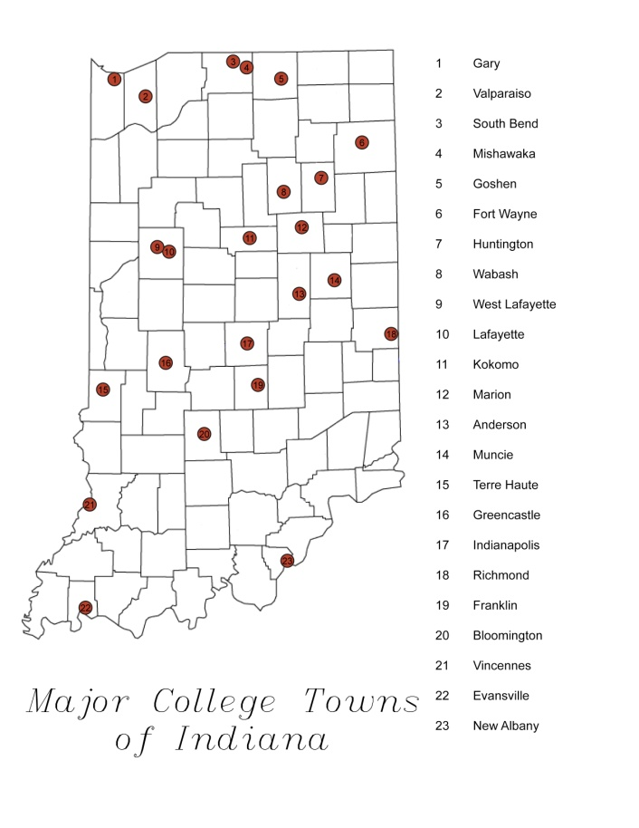
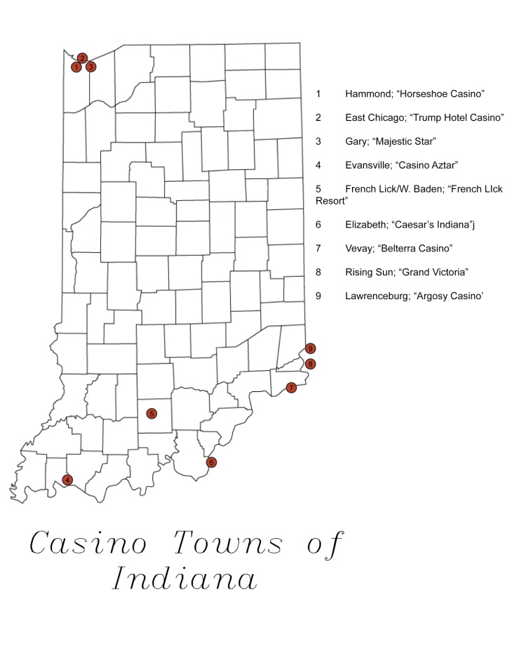
Special Assets: Colleges/ Casinos

Slide 7
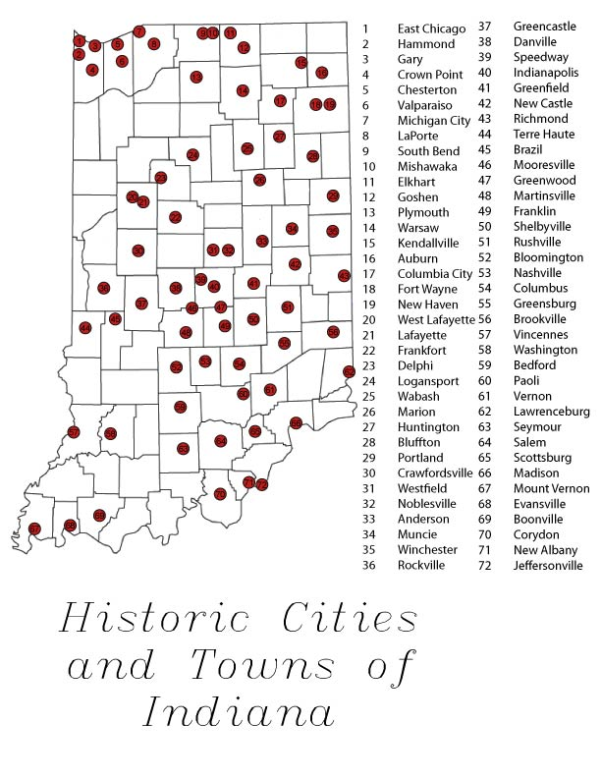
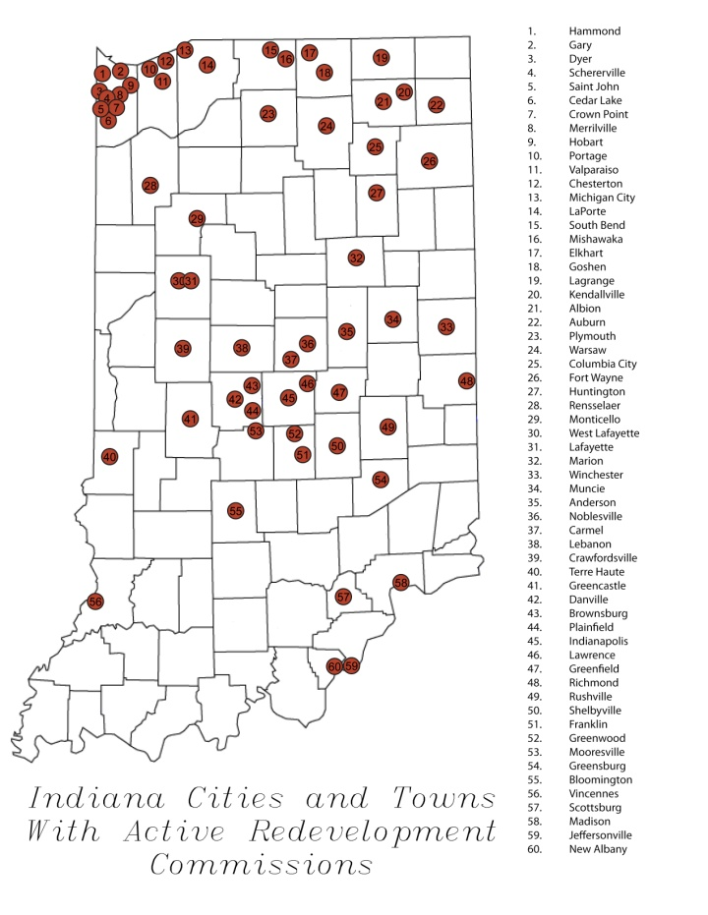
Special Assets: Historic Districts/ Redevelopment Authorities

Slide 8
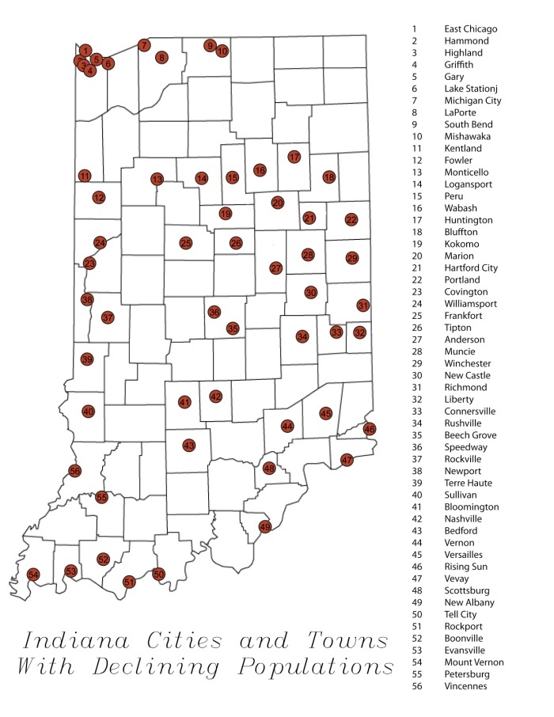
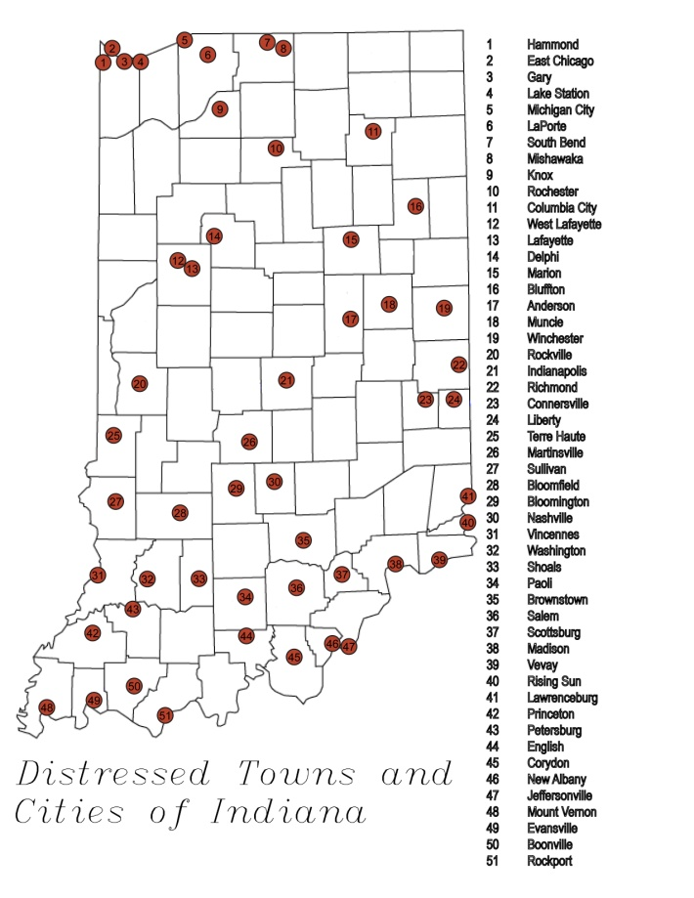
Inexorably Shrinking Cities?

Slide 9
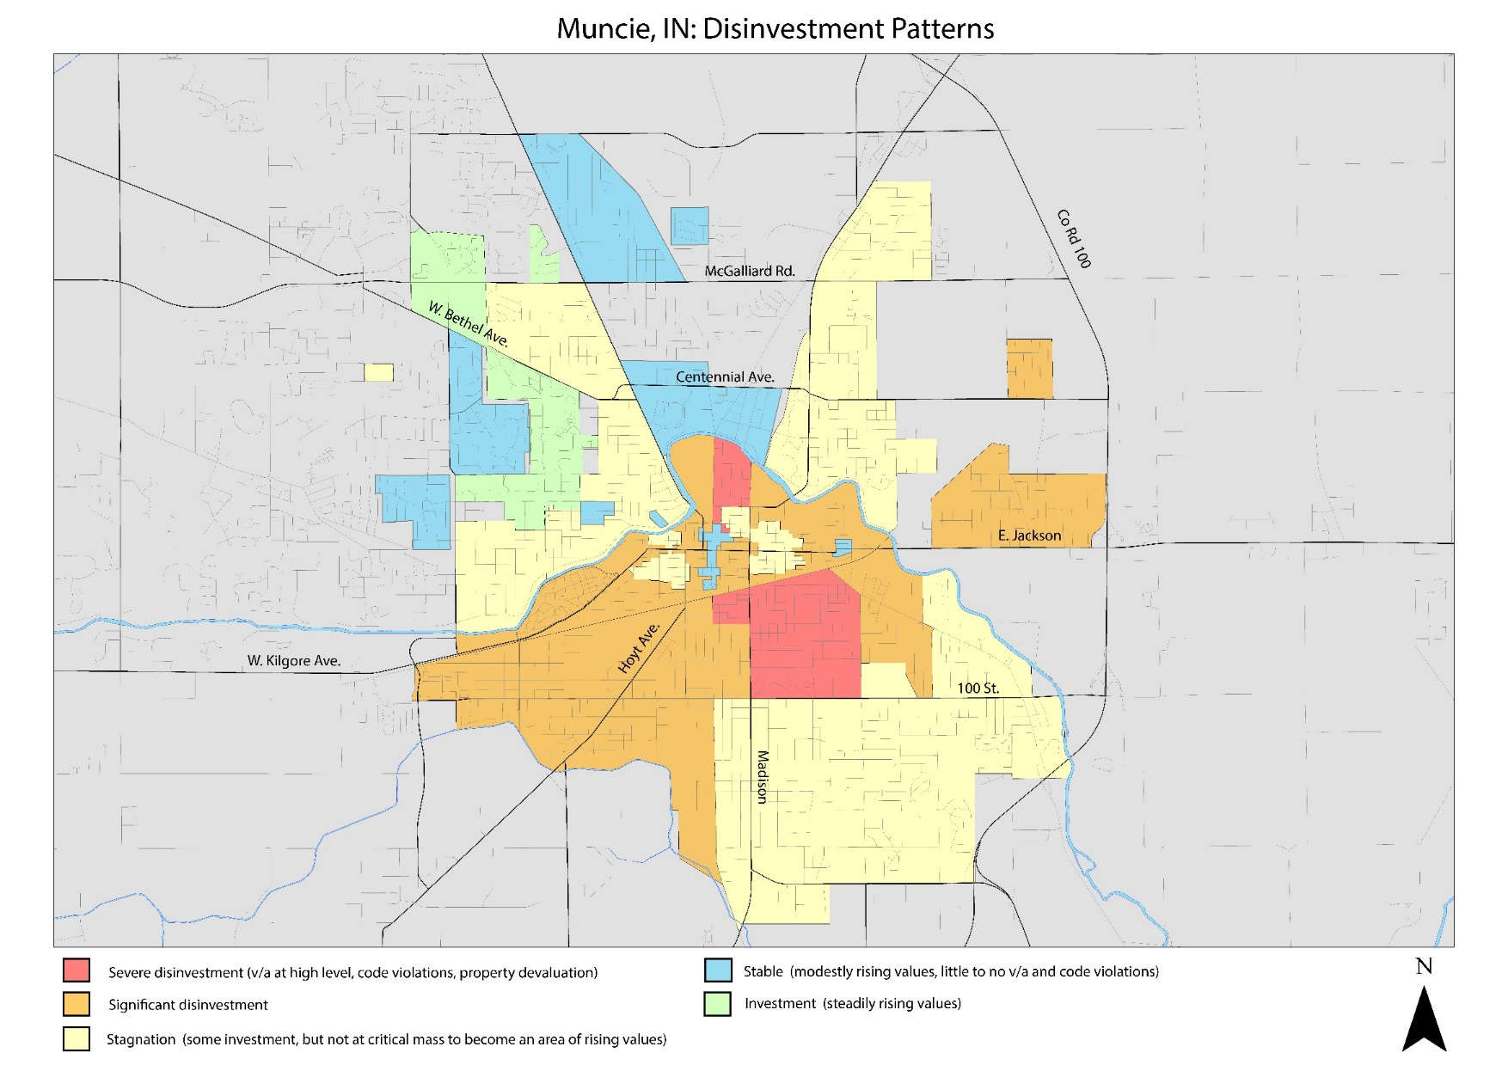
Neighborhoods of Investment & Disinvestment- Muncie
Statewide study distills to Your Community
Severe Disinvestment
Significant Disinvestment
Stagnation
Stable/Modest Investment
Investment

Slide 10
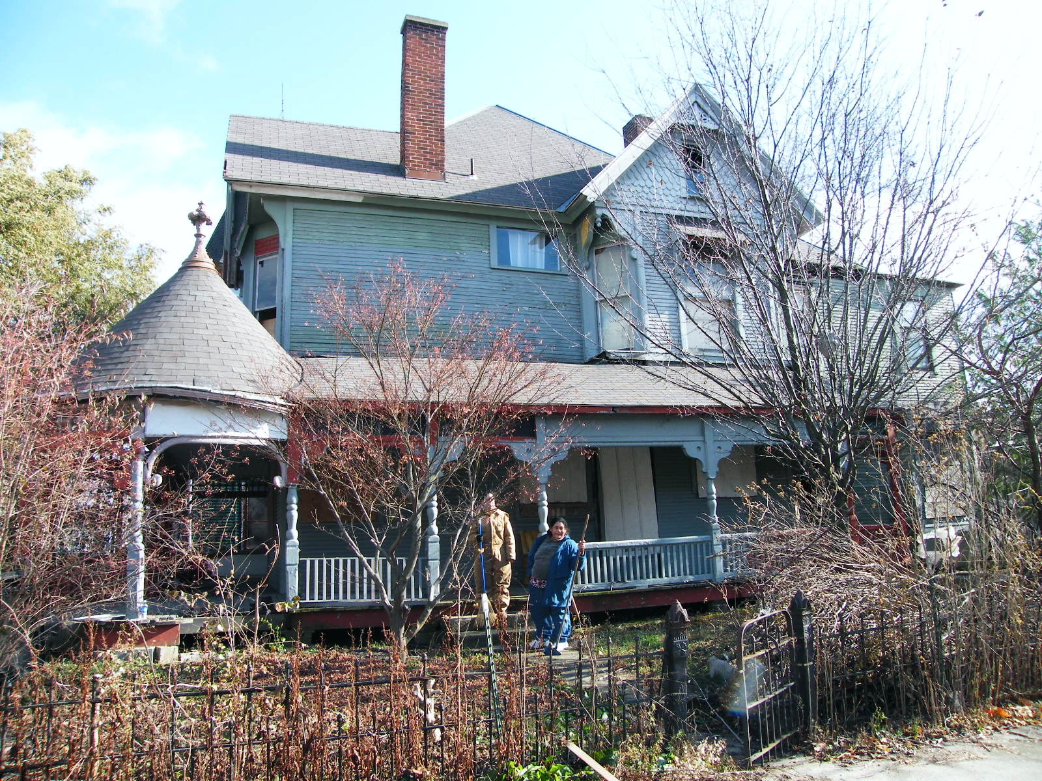
4. Residential
Muncie’s
Olde West End
November 2011
Demolition Order
Incremental
Catalytic

Slide 11
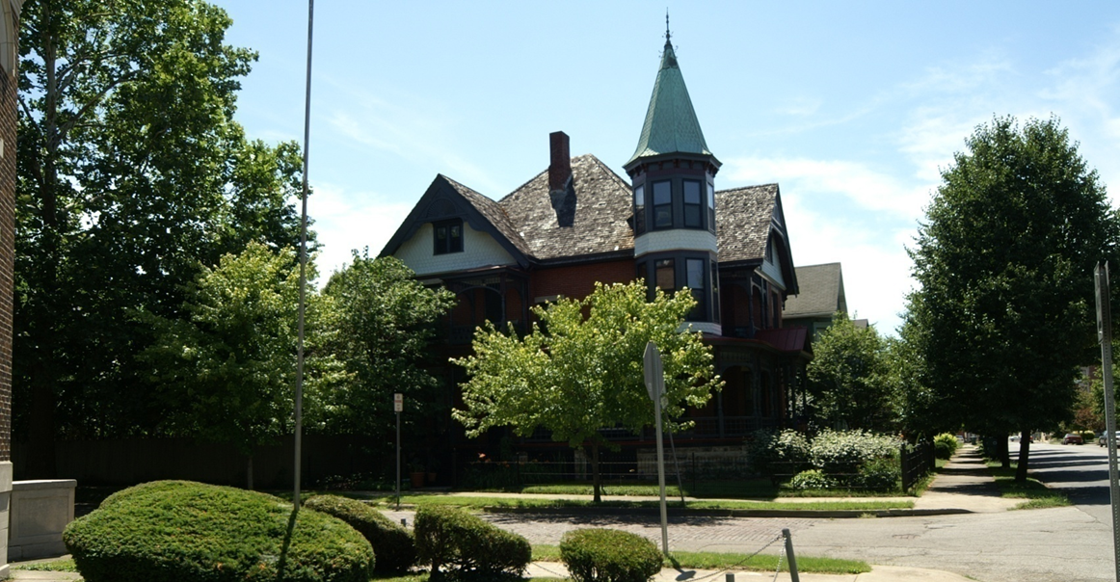
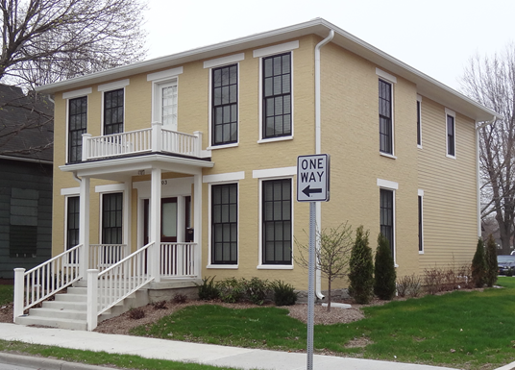
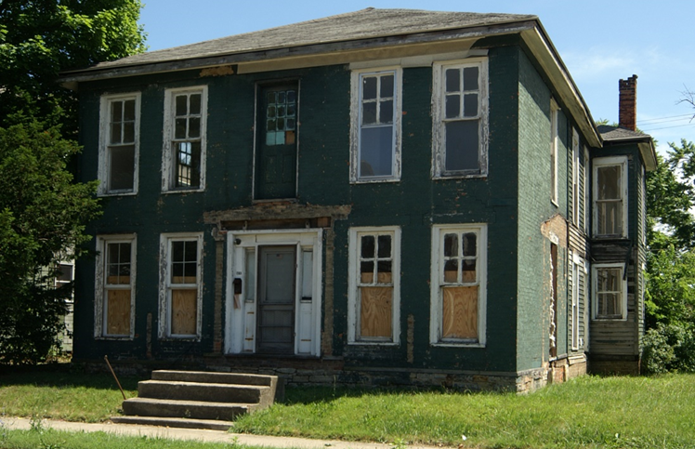
ROI
If I want to realize a return on my investment, then invest in my neighbors’ properties

Slide 12
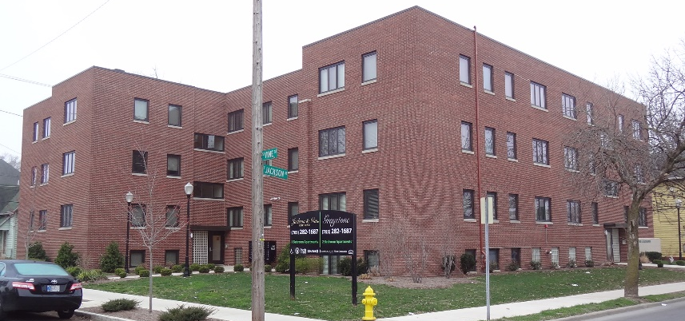
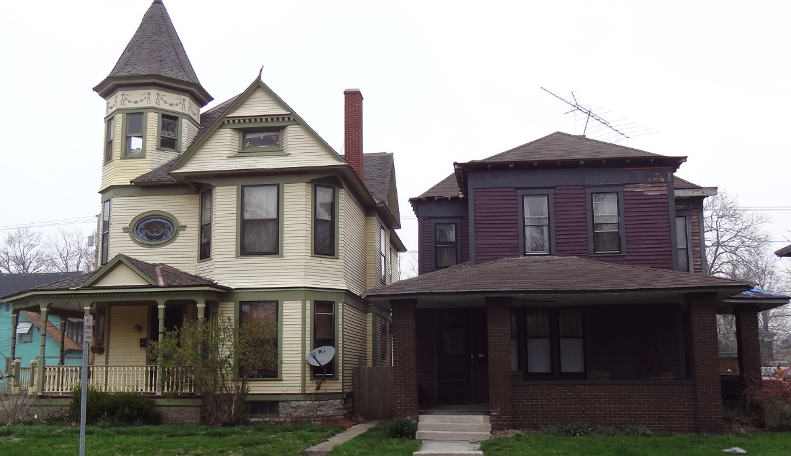
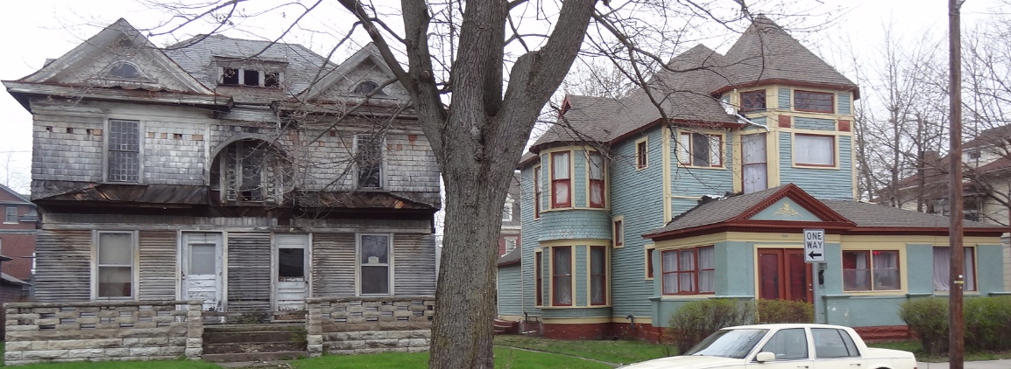
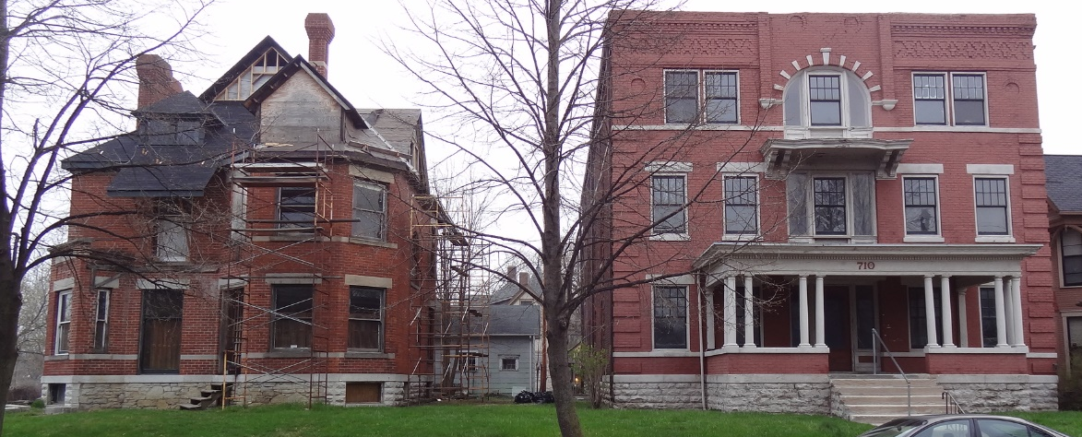
Incremental Examples Emily Kimbrough Historic District, Muncie

Slide 13
4. Underutilized Resources/ Proven Strategies
  Under-utilized tools
Mortgage Guarantees [40 FHA 203K lenders]
Tax-increment Financing [HoTIF]
Tax-credit Financing
  LIHTC [yes]
  NMTC
  HTC – IRC Sec. 50a – 5 yrs
AHP – engage the lenders [411] through FHLBI
  Under-utilized strategies
Urban Homestead rehabilitation program
CDBG/ Home Sustainable Financing
Developer-financed subsidies for affordable housing, urban amenities
Neighborhood Strategy
  Block by block
  Mixed Use
Laws of
  Large Numbers
  Small Numbers
4,5 reserved for Workshop B Neighborhood Reinvestment
Pedestrian Short List

Slide 14
4a. Mortgage Guarantees
Program | Purpose | Comment
FHA 203K National Housing Act (12 U.S.C. 1709(4k)); program regulations are at 24 CFR 203.50 | Insures lenders on mortgages for acquisition and rehabilitation up to 96.5% with lending @ or about $275K single family, $525K four-family Rehabilitation requires existing foundation 1-4 units per building Borrower or tenant is not income qualified 40 lenders in Indiana | Well-suited to redevelopment in neighborhoods of disinvestment where mortgage collateral securitization is an issue; mitigates greatly any downside risk and frees up lending. Useful to neighboring properties or to subject demolition, preserving the foundation
FHA 203K Streamlined | $30,000 for single family; $60,000 for four-family; excludes acquisition | Useful to homesteads, which may be occupied or vacant and to nonprofit landlord of 1-4 unit residences

Slide 15
4b. HoTIF
HoTIF as Section 48 of the Indiana Redevelopment Code, IC 36-7-14 | 1. Syndicate through capital markets [local or national “tranches”] – I will show you; private or public offerings [CMBS] Local Initiatives Support Corporation [LISC] in Indianapolis and headquartered in Chicago Enterprise Foundation – headquartered in Columbia, MD Duke REIT, National Equity Fund, National Multi Housing Council, Equity Residential, etc. 2. Can raise 43% of qualified basis on non-residential properties; 33% on apartments; 25% on homesteads 3. E.g. on $100,000 private financing, added public financing on capitalized tax increment $75,000 for non-residential $50,000 for apartments or rental single family homes $25,000 for homesteads [can demonstrate affordability at average low/ moderate income] | Essential to a neighborhood revitalization strategy, allowing investment in residential or mixed-use buildings containing a residential use. Tax increment is on all land uses in a HoTIF Tax Allocation District. Much more powerful than a TIF, promoting a substantial subsidy on private property without household income qualification, yet severely under-utilized in Indiana

Slide 16
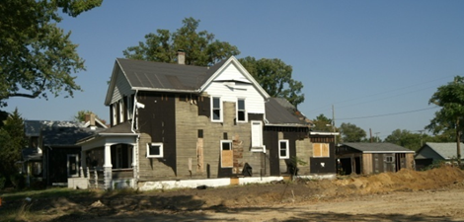
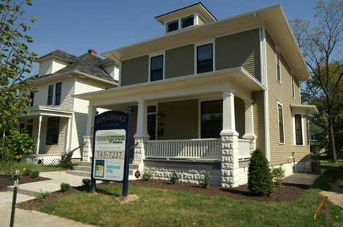
Qualifications & Uses of HoTIF [amendments 2006]
IC Title 36, Chapter 7, Section 14-et. seq.
Section 45 determination
  < 150 acres [10% of MCD land under SB 17]
  > 33% of parcels are vacant
  > 33% of residential parcels constructed before 1941
  > 33% of parcels [1 of the following]
    Unoccupied dwelling unit [“not permanently occupied”]
    Governmental order to correct housing code or unsafe building violation
    2 quarters of delinquent property tax payments
    Government owned
  > 75% of parcels for residential
Section 48 authority
  Construction/ rehabilitation
  Acquire
  Demolish
  Financial assistance to households for purchase or lease
  Financial assistance to “neighborhood development corporations” to perform the above
  Renaissance Point, Hanna-Creighton Neighborhood, Fort Wayne
NOTE: By the 2006 Code Amendments: Can use HoTIF to improve private property; thus, this creates the advantage for a multiplier effect of higher increment in assessed value, higher TIF, and reinvestment back into private property

Slide 17
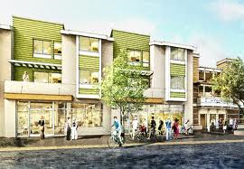
Uses of HoTIF
Essential to a neighborhood revitalization strategy, allowing investment in residential or mixed-use buildings containing a residential use.
Tax increment is on all land uses in a HoTIF Tax Allocation District
Much more powerful than a TIF, promoting a substantial subsidy on private property without household income qualification, yet severely under-utilized in Indiana
E.g., can be deployed as an affordable housing subsidy, yet no income restriction
TIF excludes homesteads
TIF on public improvements & services
Demonstration below

Slide 18
Concept 1: HoTIF as Investment
Multifamily Housing
Property Appreciation
5 Years @ 8%
$78,800
Post Development Value =
$168,000
5 Years =
$246,800
General Fund
$1,576 [440%]
TIF capitalized [MC=6%] &
re-invested private property
Public Bonds
$50,000
Total tax incr. = $3,000
Private Investment
$100,000
Underwrite
TIF $2,000
Pre-Development Value
$18,000
Tax = $360

Slide 19
HoTIF as Investment
Nonresidential Property
Apply to residential in mixed-use
Property Appreciation
5 Years @ 8%
$90,600
Post Development Value =
$193,000
5 Years =
$283,600
General Fund
$2,718 [500%]
TIF capitalized [MC=6%] &
re-invested private property
Public Bonds
$75,000
Total tax incr. = $5,250
Private Investment
$100,000
Underwrite
TIF $3,000
Pre-Development Value
$18,000
Tax = $540

Slide 20
HoTIF as Investment
Homestead Housing
Property Appreciation
5 Years @ 8%
$67,100
Post Development Value =
$143,000
5 Years =
$210,100
General Fund
$671 [375%]
TIF capitalized [MC=6%] &
re-invested private property
Public Bonds
$25,000
Total tax incr. = $1,250
Private Investment
$100,000
Underwrite
TIF $1,000
Pre-Development Value
$18,000
Tax = $180
$1.00?

Slide 21
Affordable Housing Resources
Next 2 slides consider only these programs
First or Repeat Homebuyers
First or Repeat Homebuyers
Mortgage Insurance
  FHA 203K
    $273,000 home value limit
    Acquisition & Rehabilitation
    $30,000 easy rehabilitation
    Homestead or nonprofit 1-4 plex
    40 lenders in Indiana
  FHA/ VA Insurance
    Acquisition only
Tax Credit Financing
  HTC
  NMTC
  LIHTC
Grant
  FHLBI – AHP
  $500,000
HoTIF
  25-100% capital cost
IHCDA Mortgage Credit Certificates
  20-35% of mortgage interest…max $2,000/yr.
  20% @ >$90,000 mortgage
  35% @ <$50,000 mortgage
IHCDA Next Home
  3-4% Down Payment Assistance – no purchase price or income limits
Combination IHCDA programs
  requires “1st-time” home buying
  = not owning residence last 3 years
Only 2 programs restricted by maximum household income.
Which ones?

Slide 22
Affordable Housing
4-BR dwelling
Household Need
4-BR dwelling
Affordable Pricing
Low Income for household of 6 = $31,100
Moderate Income for household of 6 = $49,800
Average Low/ Moderate = $40,450 = $3,371/mo.
$110,800
$174,350
$142,575
Will it work at $168,000?
2013 Data

Slide 23
HoTIF + IHCDA as Affordable Housing Subsidy - Homestead
Calculated at lowest HoTIF and IHCDA subsidies
Acquisition & Redevelopment | $ 168,000
LESS HoTIF [Homeowner pays taxes, City Trust pays 2nd mortgage] | $ (25,000)
LESS IHCDA Down Payment Assistance @ 4% | $ (6,720)
EQUALS Conventionally Financed Price | $ 136,280
LESS any Buyer Down Payment or Developer Subsidy | $ -
EQUALS Amortizing Mortgage [LTV=LTC] | $ 136,280
Affordability Calculation
Monthly Mortgage Payment [annual mortgage constant @ 0.073] | $ 829
PLUS Monthly Property Tax Payment [annual @ 1.0%] | $ 140
PLUS Monthly Hazard Insurance [annual @ 0.325%] | $ 46
LESS IHCDA Mortgage Credit Certificate @20% [max @35%] & 6.0% interest | $ (136)
EQUALS Total Effective Housing Payment [TEHP] | $ 878
TEHP/ Household Income @ $3,371/ month | 26%
Compare to Section 8 Fair Market Rent [2014, Muncie metro] | $ 1,182
TEHP - Sec 8 rent same dwelling unit | $ (304)
Within FNMA underwriting

Slide 24
Same, but for a Mixed-Use Project – “Luxury” Condo
Calculated at higher HoTIF and lowest IHCDA subsidies
Acquisition & Redevelopment | $ 168,000
LESS HoTIF [Homeowner pays taxes, City Trust pays 2nd mortgage] | $ (100,000)
LESS IHCDA Down Payment Assistance @ 4% | $ (6,720)
EQUALS Conventionally Financed Price | $ 61,280
LESS any Buyer Down Payment or Developer Subsidy | $ -
EQUALS Amortizing Mortgage [LTV=LTC] | $ 61,280
Affordability Calculation
Monthly Mortgage Payment [annual mortgage constant @ 0.073] | $ 373
PLUS Monthly Property Tax Payment [annual @ 1.0%] | $ 140
PLUS Monthly Hazard Insurance [annual @ 0.325%] | $ 46
LESS IHCDA Mortgage Credit Certificate @20% [max @35%] & 6.0% interest | $ (61)
EQUALS Total Effective Housing Payment [TEHP] | $ 497
TEHP/ Household Income @ $3,371/ month | 15%
Compare to Section 8 Fair Market Rent [2014, Muncie metro] | $ 1,182
TEHP - Sec 8 rent same dwelling unit | $ (685)
Condo @ $168K more likely $86K in reality
source:
multifamily developer
Assumes non-residential of equal value as residential; capitalized HoTIF $75K + $25K
Creative class argument

Slide 25
Urban Homesteading
Doesn’t this work well with FHA 203K mortgage insurance?
IC 36-7-17
1981
$1 + administrative costs
Reversion
  under a material breach of performance [“conditional sales”] contract
  may extend 2 years
Qualified Ownership
  Receives rehabilitation loan
  Rehabilitation complies with 24 CFR 203, et. seq.
  Additional, at discretion of locality
Local Government designates administrator
  Agency [existing or new] – e.g.,
    Redevelopment Commission/ Authority
    Community Development Office
    County Treasurer
  Quasi-public corporation
    Board of Public Works
    IRC 509a or 506 [public-private]
e.g., standards: < 120% AMI > 30% currently on housing No nepotism/ cronyism Qualifies for a sufficient loan | Up to code in 6 months Energy efficient standards 5 years principal residence Maintain adequate insurance

Slide 26
4c. Tax Credit Financing – on investment properties
Program | Purpose | Comment
Historic Tax Credits & Syndication | Either commercial property owner keeps as incentive OR Syndicated Federal HTC at 20% calculates to 18% of qualified basis Indiana HTC at 20% calculates for 12% of qualified basis Federal also at 10% non-historic properties built before 1936 | Despite under-appropriated Indiana HTC’s [11-year queue], the Federal HTC is practically unlimited in subsidization on investment properties on the Register. Proposals in Congress 2014 to eliminate & to enlarge to 30-32% credit [energy] & on buildings 50 years + [S. 1141] $106B leveraged nationwide since 1976 for ~40K structures. $20.5B in tax credits generating $26B in Federal revenue, 58K in annual jobs.
Low Income Housing Tax Credit | Rental housing only at 60% AMI For new construction: 9% credit for 10 years calculates to 63% if qualified basis For substantial rehabilitation, 4% credit for 10 years calculates to 28% of qualified basis | Active syndication value, though allocations limited by Feds as administered by IHCDA; promoting reconstruction on lots where demolition has been deployed under the BEP program
NHPA 1966, amended 1976
Apartments + nonresidential

