Slide 1



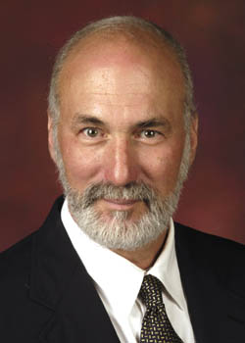

“Blight Elimination Program” Initiative of
IHCDA’s Hardest Hit Funds:
Repurposing Demolished Sites
Reinvesting in Neighboring Properties
Presentations 4/8 – 4/22/2014
Site selection, control, reuse
PART A
10:00-noon
Bruce Frankel
Professor of Urban Planning
Director, Real Estate Development Programs

Slide 2
PARTS
Guidelines to Conduct Workshop
Myths & Premises
Getting Started
Repurposing
Break for Lunch
Afternoon Workshop

Slide 3
PART 4
Repurposing
Extended Lot
Urban Agriculture
Public/ NGO
Residential
Nonresidential
Mixed Use

Slide 4
Rain Garden considerations

Slide 5
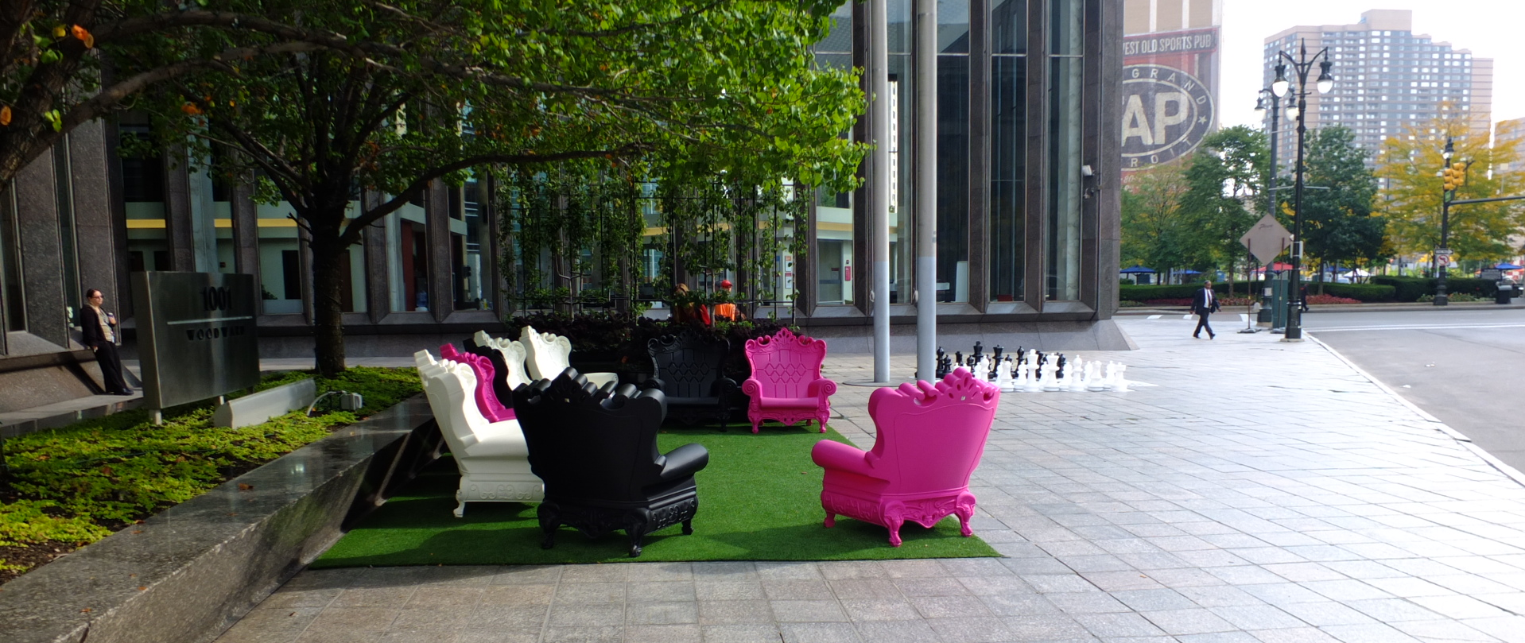
E. Neighborhood Art + Park - Detroit

Slide 6
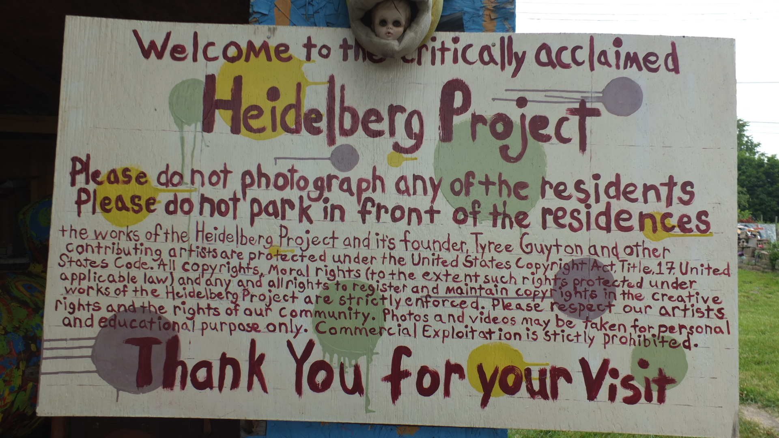
Detroit
2nd most popular tourist attraction
The Heidelberg Project, 3600 Heidelberg Street

Slide 7
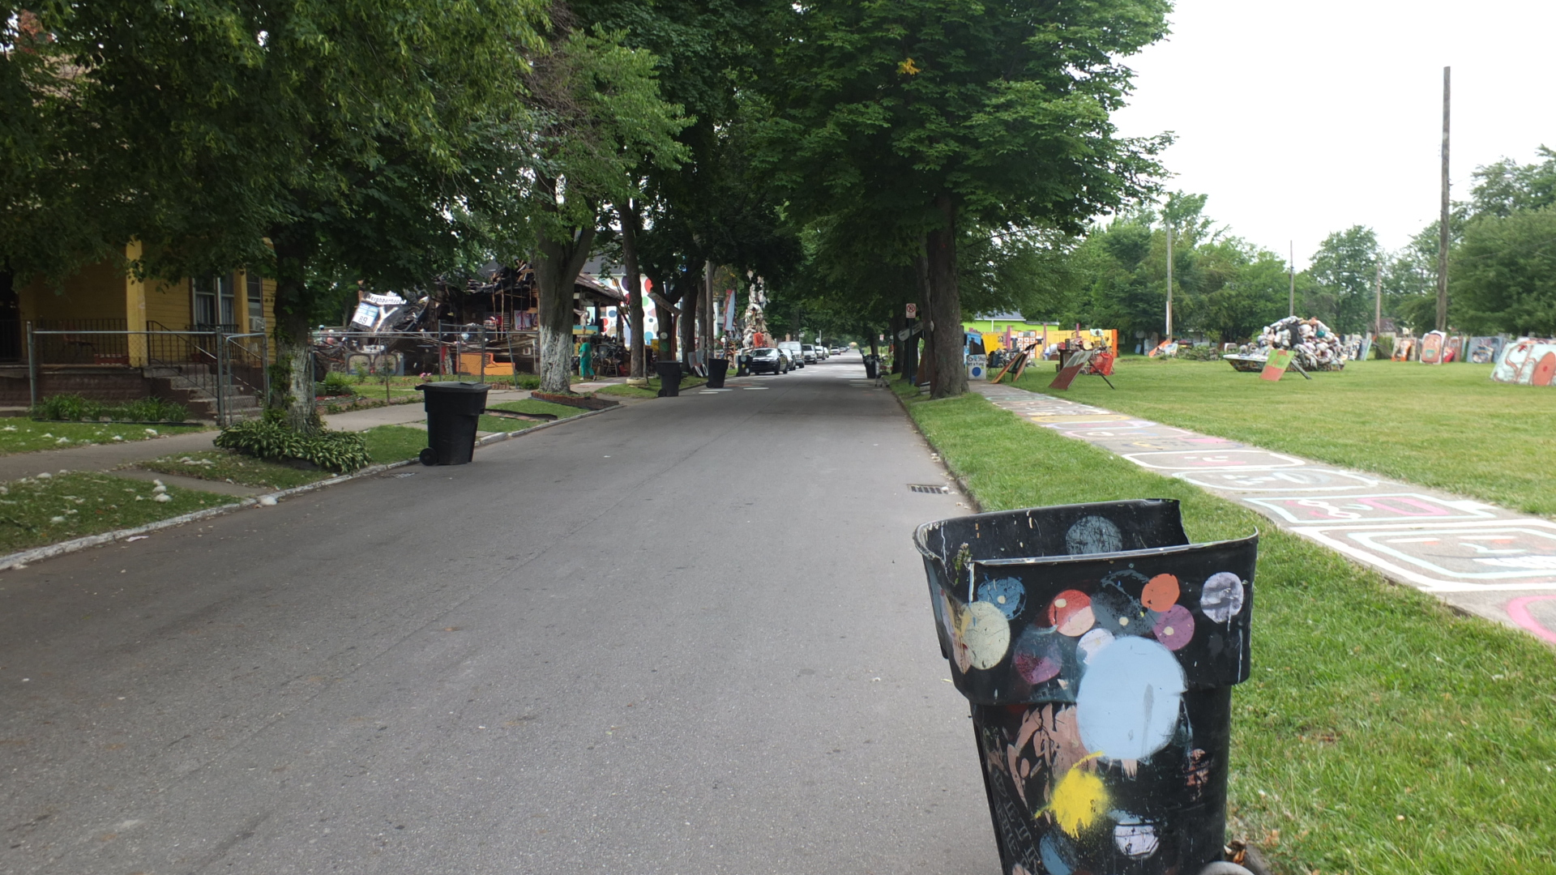
Heidelberg

Slide 8
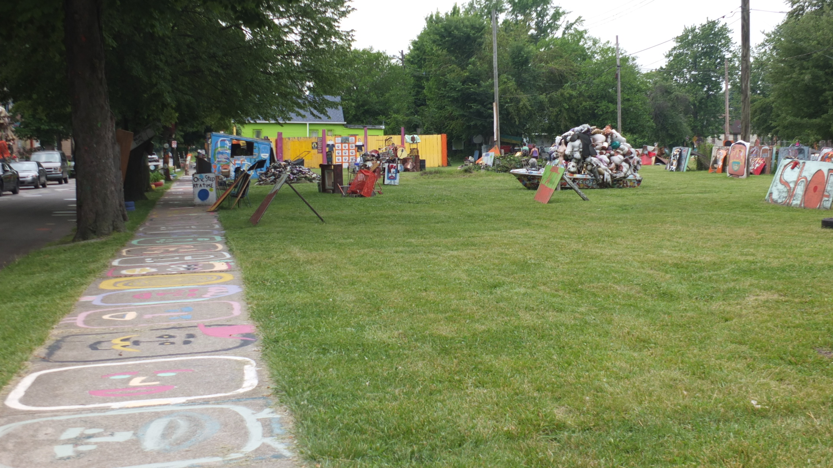
Heidelberg

Slide 9
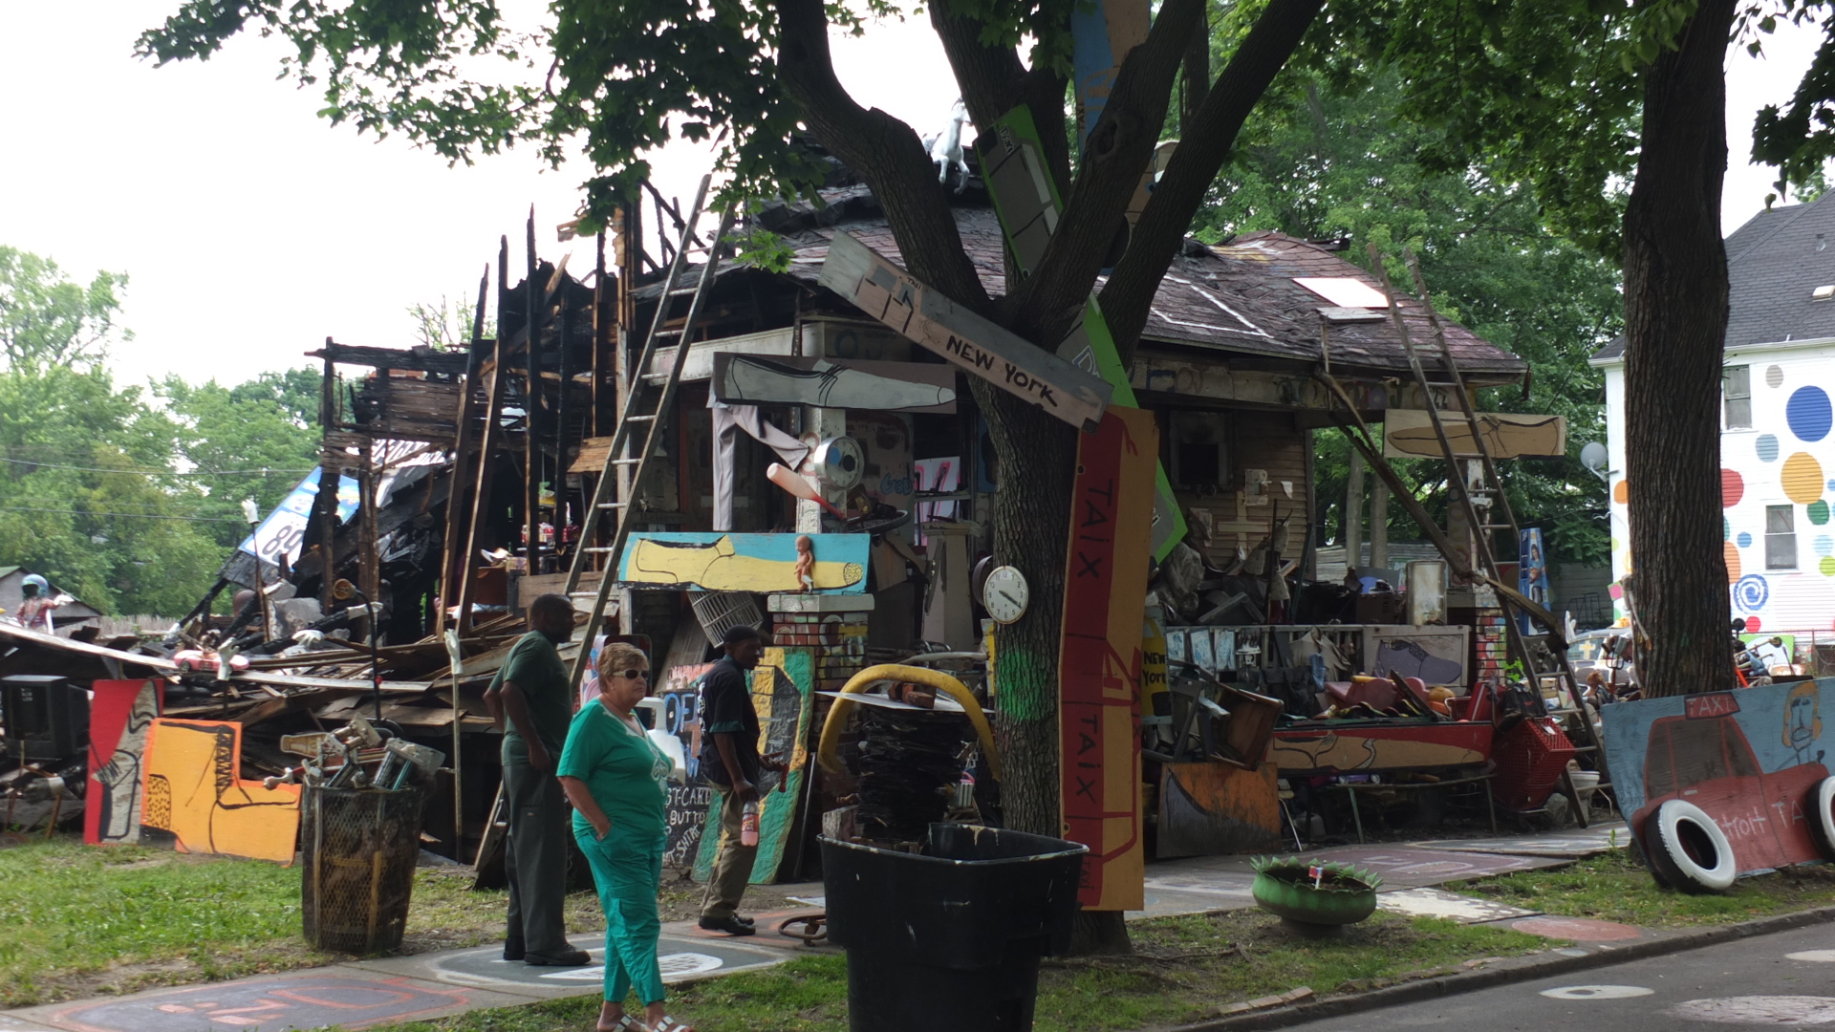
Heidelberg

Slide 10
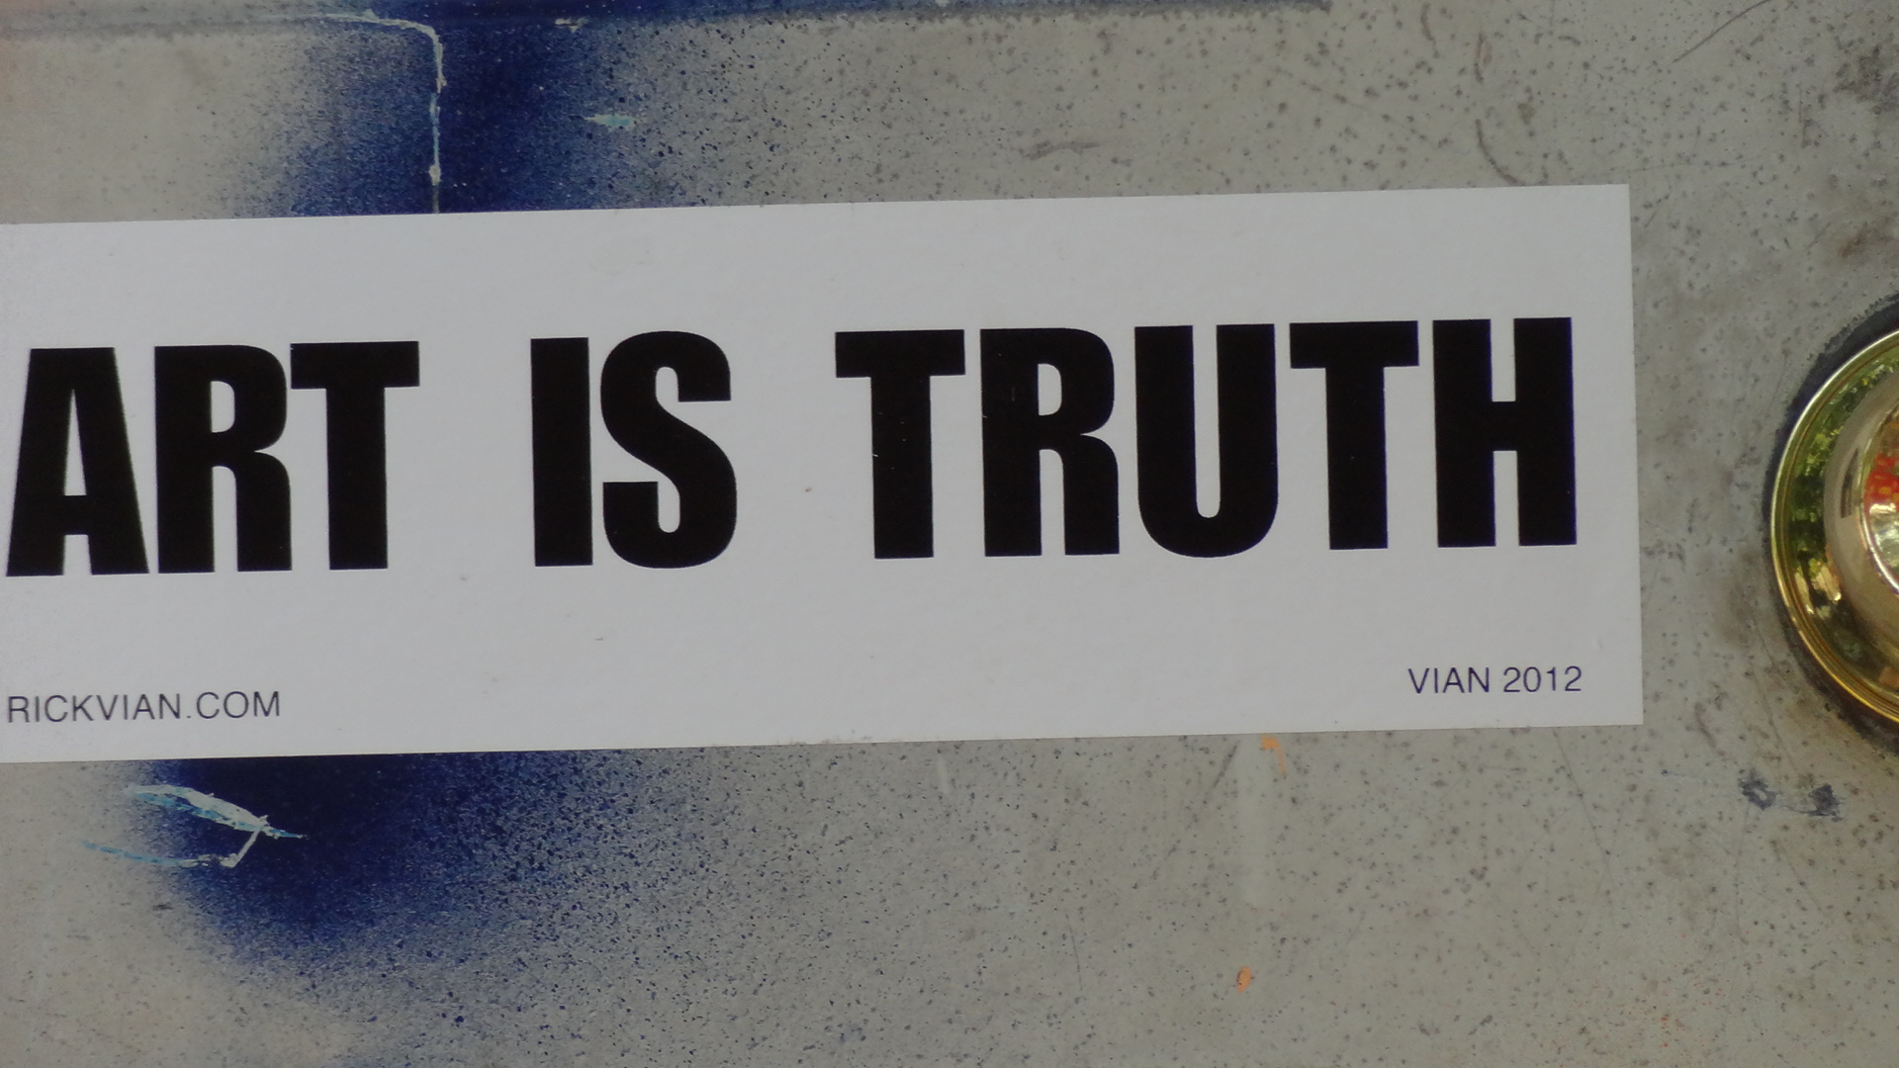
Heidelberg

Slide 11
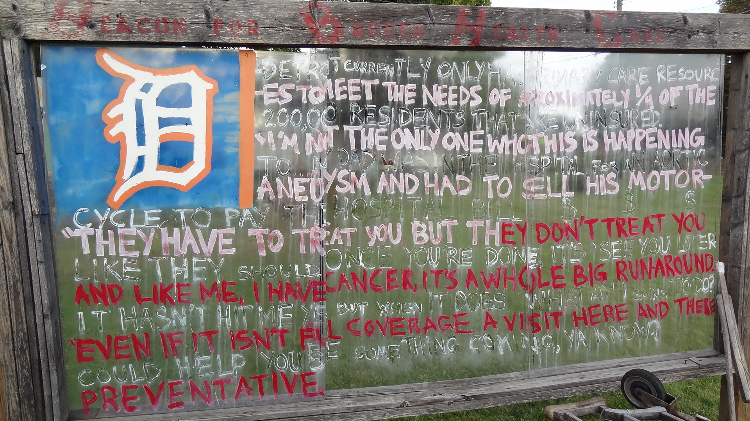
Heidelberg

Slide 12
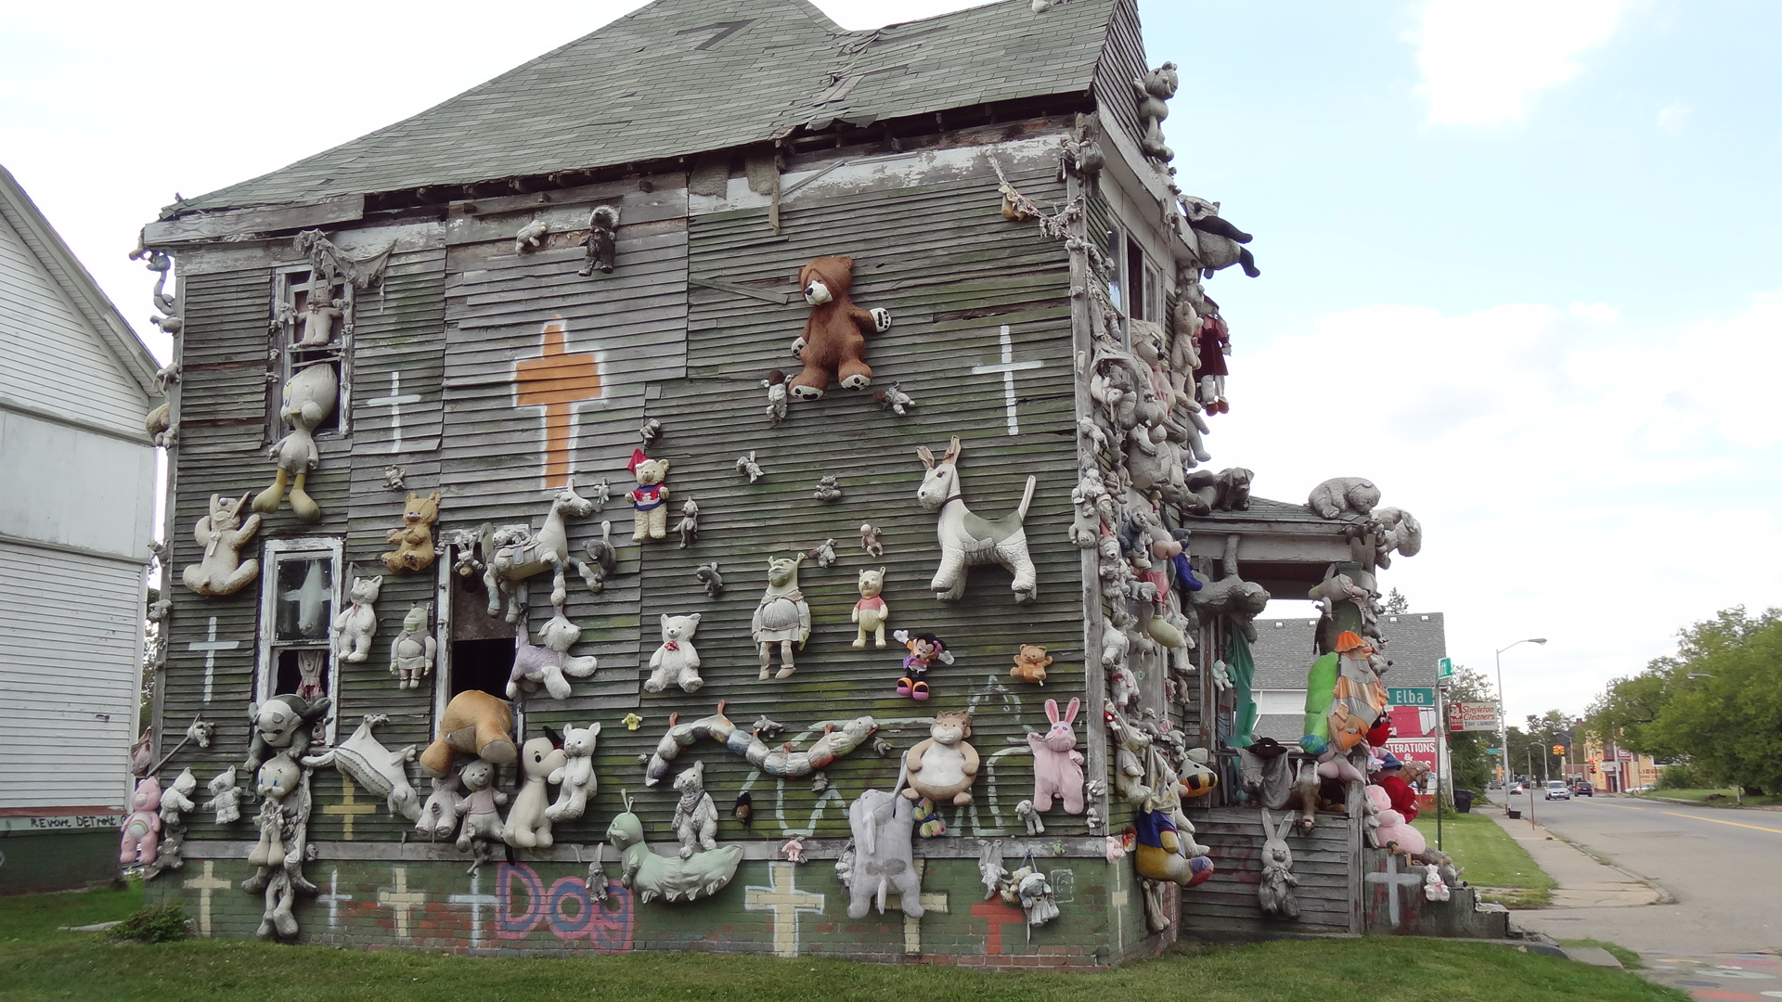
Heidelberg

Slide 13
Resources
Guides to Demolition & Redevelopment

Slide 14
Website
http://www.877gethope.org/blight
http://www.in.gov/ihcda/2340.htm
PowerPoints
Resources Round 1 Workshops as “primers”, “best practices” & “position papers”
Resources Round 2 Workshops on “elements” & “calculators” for business plan
Blog
IHCDA Materials

Slide 15
Folders
Afternoon Session A + Workshop B
Morning Session Workshop A
PowerPoints Frankel
PowerPoint IHCDA
Repurposing Strategies
Incremental Repurposing
Ordinances
Corporate Partner
Catalytic Redevelopment
Finance
Income Limits Federal Programs
Scholarly Studies Redevelopment
Repurposing Strategies
Workshop A
Workshop B
Morning
AFTERNOON
Morning
Afternoon
For BEP Program

Slide 16
Break
Repurposing
Residential
Non-residential
Mixed Uses
Resources
Introduction - Strategies for Neighborhoods
NRSA
Preview of Afternoon Session
1:00 – 3:00 pm

