Slide 1



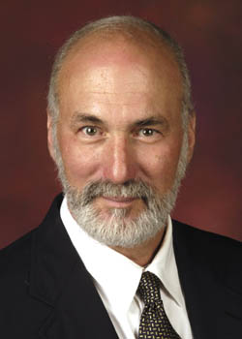

“Blight Elimination Program” Initiative of
IHCDA’s Hardest Hit Funds:
Repurposing Demolished Sites
Reinvesting in Neighboring Properties
Presentations 4/8 – 4/22/2014
Site selection, control, reuse
PART A
10:00-noon
Bruce Frankel
Professor of Urban Planning
Director, Real Estate Development Programs

Slide 2
PARTS
Guidelines to Conduct Workshop
Myths & Premises
Getting Started
Repurposing
Break for Lunch
Afternoon Workshop

Slide 3
PART 4
Repurposing
Extended Lot
Urban Agriculture
Public/ NGO
Residential
Nonresidential
Mixed Use

Slide 4
1. Extended Lot
A
V
B
What are the net merits of subdividing V?
…of relying on the Property Maintenance Code or a Deed reversion clause?

Slide 5
Cost
1 side yard $4,668
2 side yards
$5,767

Slide 6
2. Urban Agriculture
Soil Conditions
  Pollutants
  Debris
  Compacted
Water Access
Permits
  Zoning Code
  Building Code
Equipment
Fencing/ Security
Native Plant Selection
Budgets
  Vineyard
  Orchard
  Market Garden
  Community Garden

Slide 7
A. Vineyard
$4,923

Slide 8
B. Orchard
$3,718

Slide 9
C. Market Garden
$3,659

Slide 10
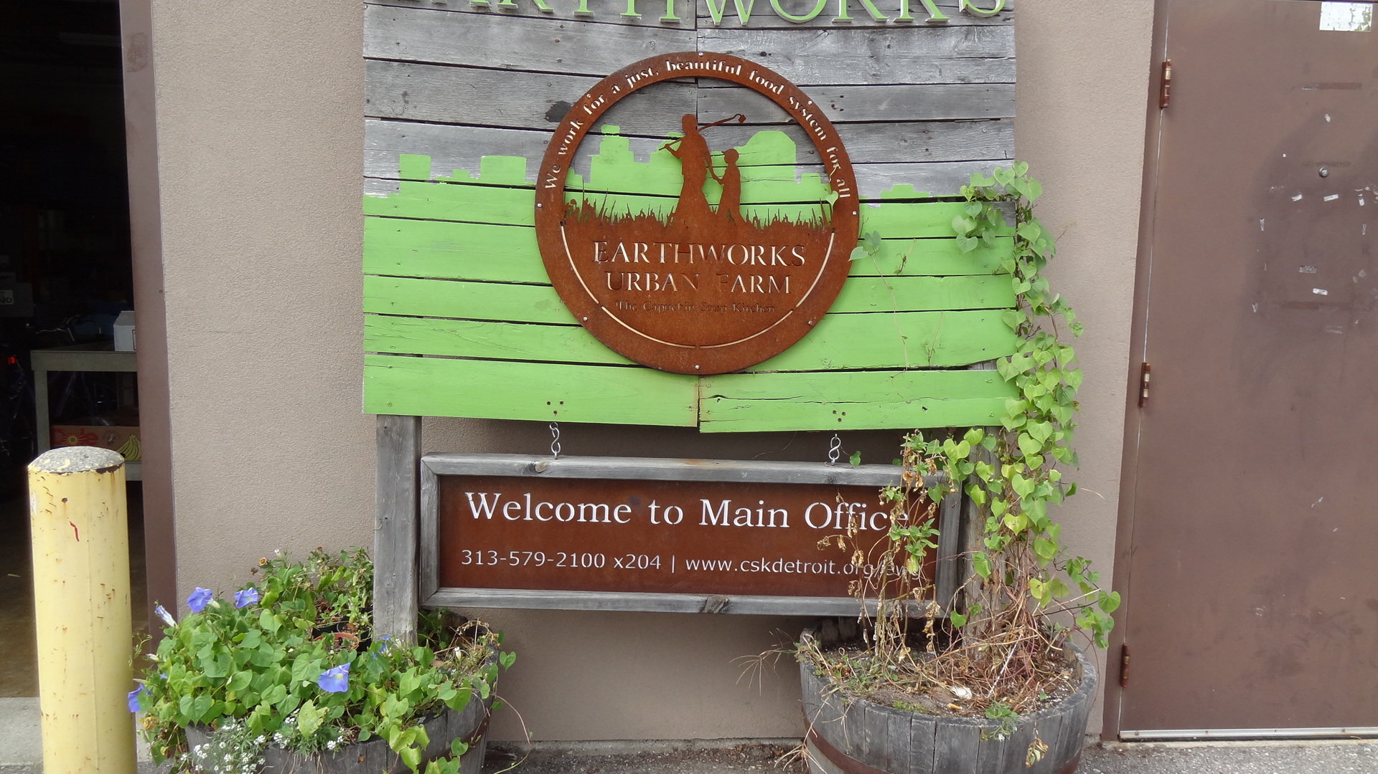
Earthworks - Detroit

Slide 11
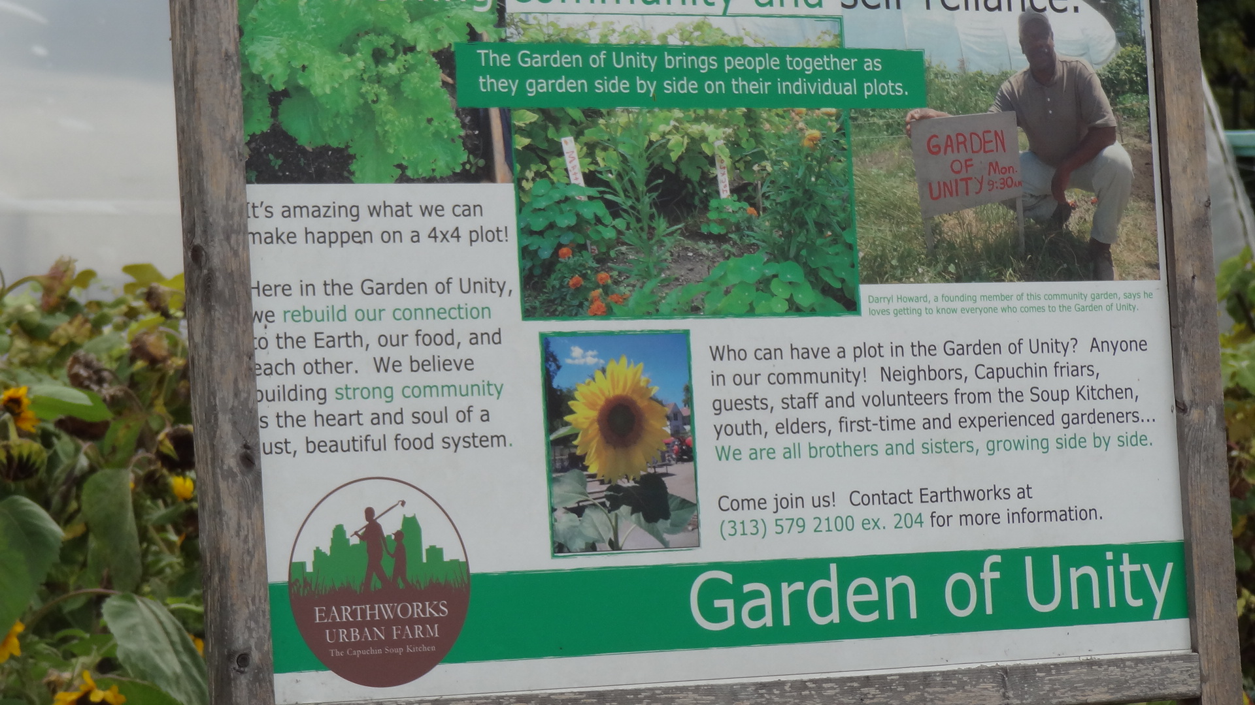
Earthworks

Slide 12
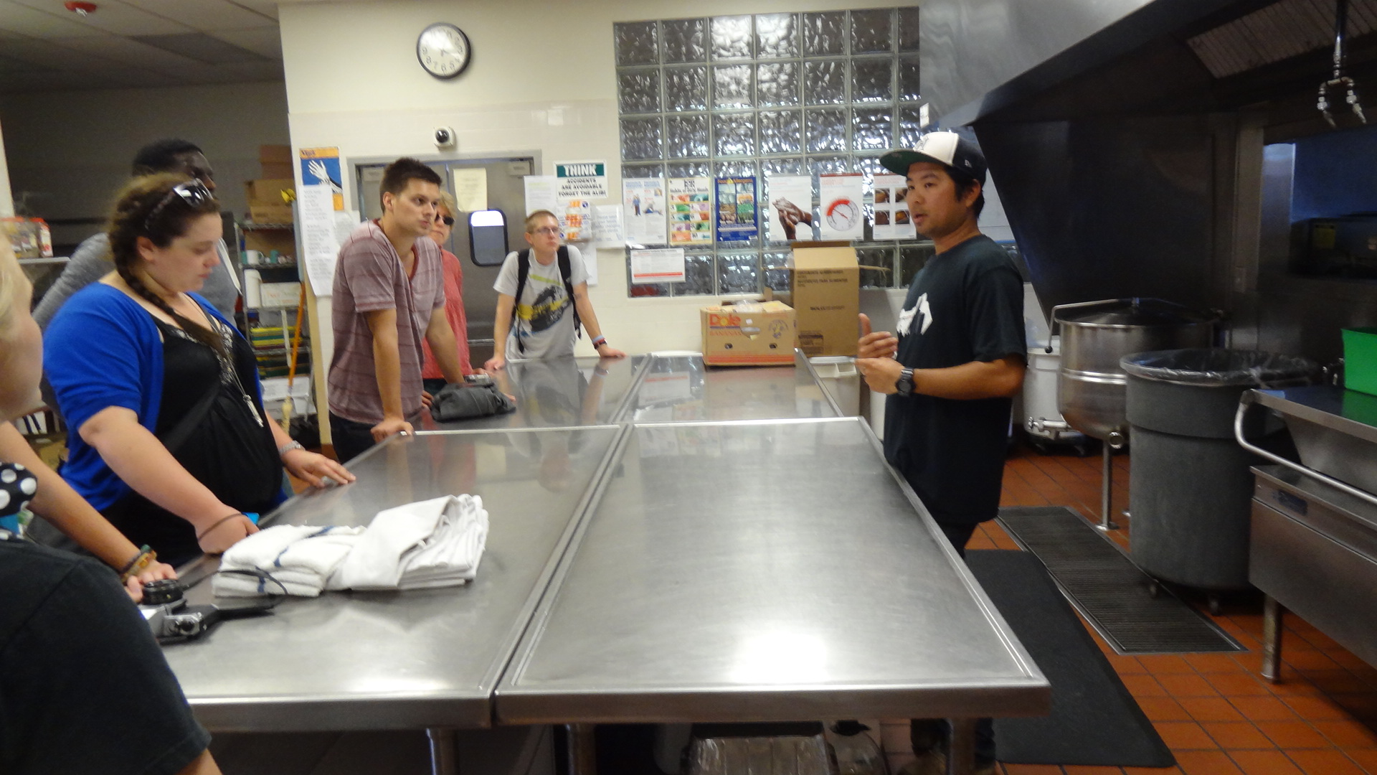
Earthworks
Shane Bernardo: Outreach Coordinator

Slide 13
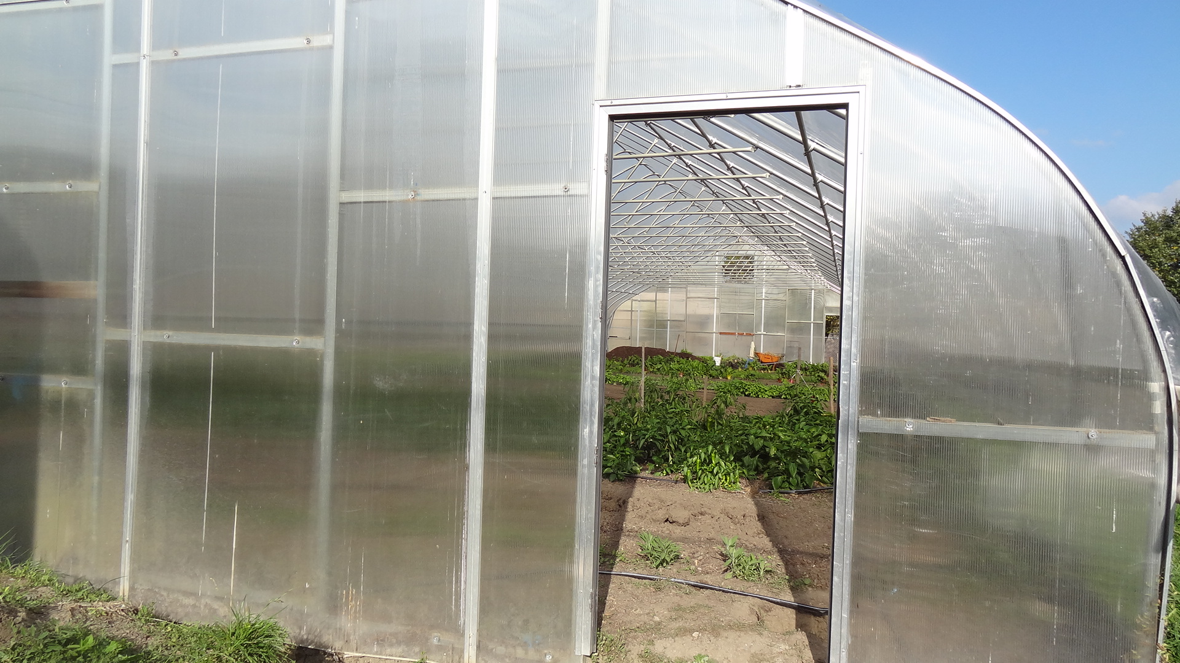
Earthworks

Slide 14
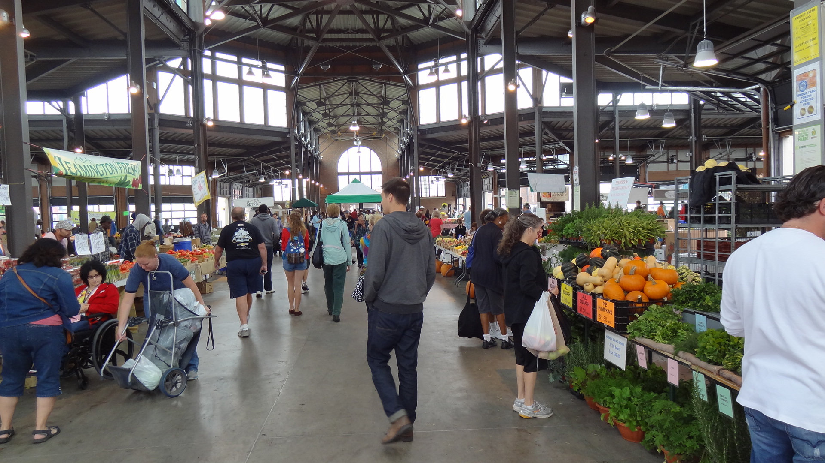
To Market

Slide 15
D. Community Garden $5,577

Slide 16
Kent State Urban Design

Slide 17
3. Public/ NGO
Public Open Space
  Land Bank Street Edge Improvements
  Neighborhood Pathway
  Neighborhood Pocket Park
  Rain Garden [Neighborhood Hydrology]
  Public Art
Public Facility
  Community School
  Community Center
  Economic Development Incubator

Slide 18
A. Land Bank Street Edge Improvements
$546

Slide 19
I would add a 3’ fence

Slide 20
B. Neighborhood Pathway
$8,446

Slide 21
Mid-block walkability
I would add fencing

Slide 22
C. Neighborhood Pocket Park $6,094

Slide 23
Pocket Park

Slide 24
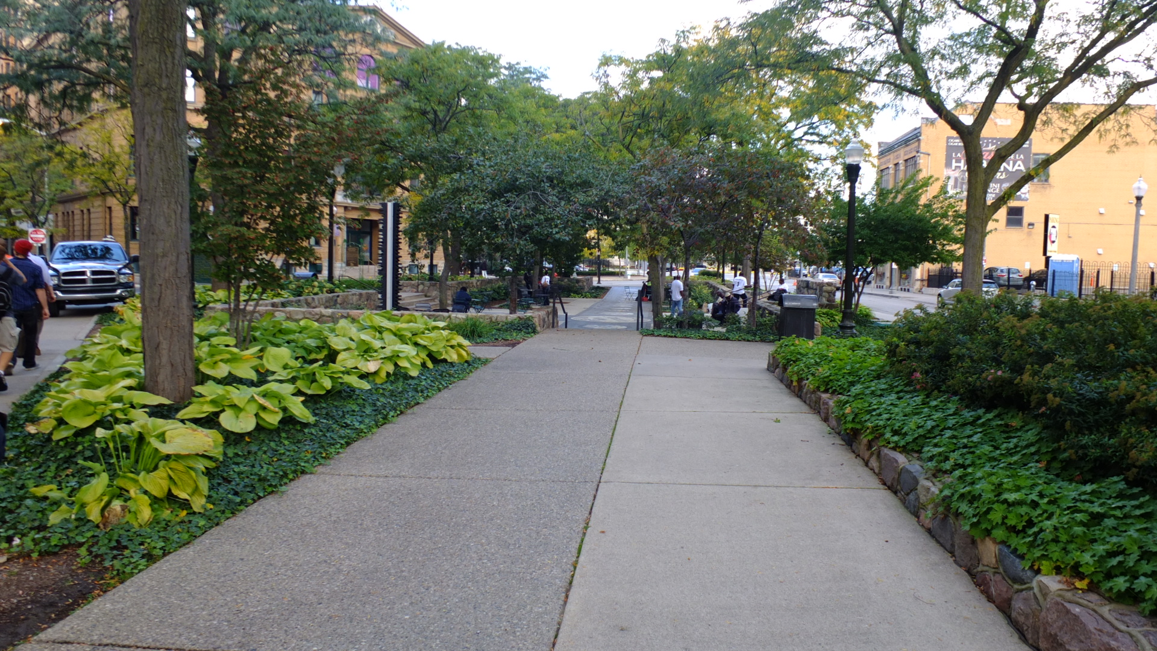
Public Park - Detroit
Barrett’s Law

Slide 25
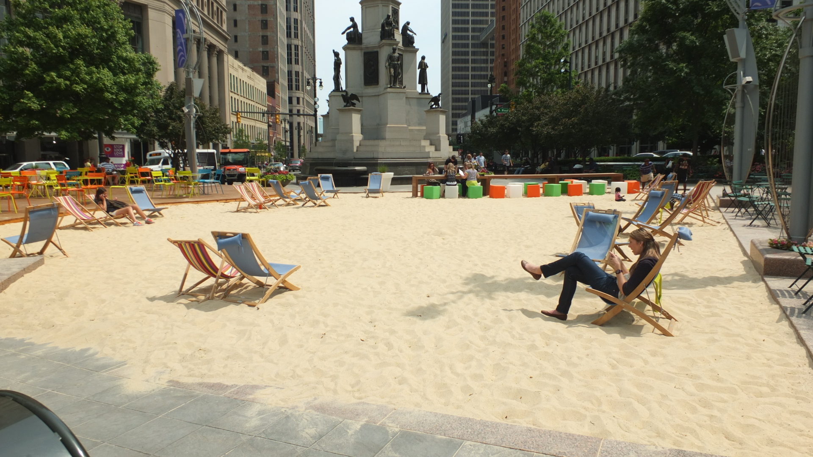
Campus Martius - Detroit

Slide 26
D. Neighborhood Rain Garden [Hydrology]
$1,128

